Slide 1
Update on target fields for rf shimming
April 3, 2020

Slide 2
Target field design
Address the following challenges
Dielectric constant -> short wavelength
Conductivity -> attenuation
Inhomogeneous material properties -> Reflection/refraction at boundaries
Goal: Minimize the coefficient of variation (CoV) of|B₁⁺|
Over the space of solutions of Maxwell’s Eqns
Notes:
A target field design should address the following challenges…
Maybe a good approach is to tackle these challenges one at a time…

Slide 3
Overcoming wavelength effects
A uniform plane wave has uniform |B₁⁺|
Notes:
The solution of the inverse problem is the incident wave that refracts in just the right way to produce an internal traveling plane wave.
[Video file is gMie_Hy_NSv5_6thOrder_20151106_x4.mov]

Slide 4
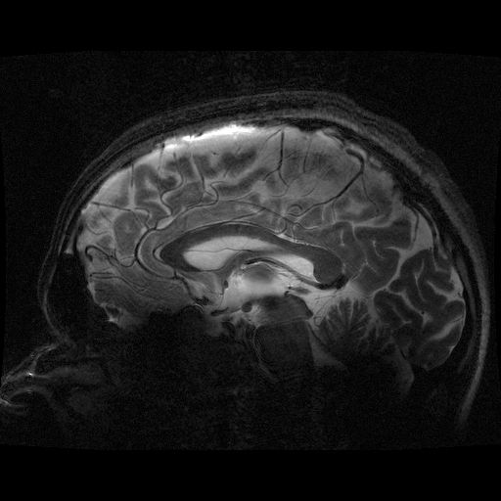
Target field synthesis
What external field would produce the desired plane wave field in the brain/body?
Measure the coupling between
Incident field modes (transmitted by the rf coil)
Internal field modes (within the sample)
If the target field is known, solve the inverse problem:
What combination of incident modes makes the internal target field?
Notes:
We want to know “what incident modes will combine to make a target internal field?”

Slide 5
multilayered samples
Coupling matrix describes the relation between transmitted and internal (VOI) mode amplitudes
even for multiple intervening layers
Full column rank guarantees a solution to the inverse problem
Coupling matrix is calculated from field maps, acquired prior to scan
Notes:
A real head is a multilayered structure, where the brain is encased in the skull, which is inside a layer of extracranial tissue.
But the coupling matrix can still describe the relation between the incident and internal fields.

Slide 6
Effects of conductivity
|B_{y}|
Conductive losses cause attenuation of a plane wave as it traverses the head
B₁ is uniform in planes perpendicular to propagation direction
Notes:
What about the effects of conductivity?

Slide 7
Overcoming conductivity effects
Balance attenuation with field focusing
A superposition of plane waves (or other basis functions) can produce a converging wave to balance conductive losses
Synthesize nearly uniform |B₁⁺| fields
CoV(|B₁⁺|) = 5% over the volume
Notes:
We can overcome most of the conductivity effects by balancing attenuation with field focusing….
Simulated annealing optimization of 46 plane wave directions.
[Video is showH1plusTimeDependence_h1plus_ellipsoid_02-May-2016_1024.mp4].

Slide 8
Overcoming conductivity effects
|B₁⁺|
Balance attenuation with field focusing
A superposition of plane waves (or other basis functions) can produce a converging wave to balance conductive losses
Synthesize nearly uniform |B₁⁺| fields
CoV(|B₁⁺|) = 5% over the volume
Notes:
[image is rfShimSimAnnealWrapper2_ellipsoid_H1plus.tiff]

Slide 9
Dependence on conductivity
How does the target field depend on brain conductivity?
Zero conductivity -> plane wave
Increasing conductivity ->
Greater attenuation
Stronger wave front focusing required to balance attenuation
Notes:
This defines a family of target fields….
Sigma ranges from 0 to 0.677 Siemens/m (~0.5 is average for brain at 7T).
Cylindrical phantom (8 cm radius, 12 cm length). Z axis is horizontal in image frame.

Slide 10
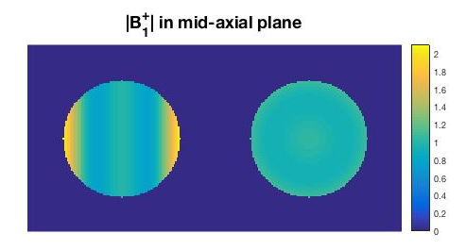
Comparison to previous work
Previous target field (Wang and Chu)
Planar wave optimized over volume
CoV(|B₁⁺|) = 23.8%
TIPS optimization
CoV(|B₁⁺|) = 4.2%
Wang and Chu (JMRI, 2006)
TIPS
Notes:
These solutions can be compared to a previous target field…
Simulation parameters:
B0 = 7T
Sigma = 0.5 S/m
Epsilon (relative) = 60
sphereR = 8 cm
Reference: Wang and Chu, JMRI 24: 218-225 (2006).
Figure created using optWangTarget.m.

Slide 11
Target field in a More realistic head model
Goal: Minimize CoV(|B1+|) in HFSS ‘Cerebrum’ volume
Simulated annealing of plane waves with different propagation directions
Uniform electrical properties
CoV(|B₁⁺|) = 2.2%
Notes:
rfShimPlaneWaveSimAnnealWrapper8_complexFieldInHfssHead_20191120.tif

Slide 12
Target field in a More realistic head model
Goal: Minimize CoV(|B1+|) in HFSS ‘Cerebrum’ volume
Simulated annealing of plane waves with different propagation directions
Uniform electrical properties
CoV(|B₁⁺|) = 2.2%
Can this be produced by a coil array?
Notes:
rfShimPlaneWaveSimAnnealWrapper8_magnitudeFieldInHfssHead_20191120.tif

Slide 13
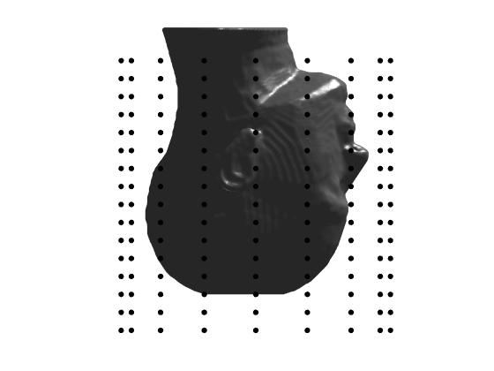
Simulation parameters
Ideal magnetic dipoles on a cylindrical surface
array geometry
Grid of N_{z}=16, N_{φ}=16 positions
Loop geometry
Loops in surface
Composite (3 axis) loops
HFSS head model at 300MHz
Simulated RF shimming
Superposition of B₁⁺ fields from loops
Optimized using Linear Least Squares fitting
Regularized using Singular Value Decomposition
Resources
Time: about 4 hours/loop (128 days for 16x16 composite loops!)
RAM: At least 70GB for reliable convergence (up to 11 passes)
CPU: 25% (10 cores)
Output file Disk space: ~1TB for 16x16 grid of composite loops

Slide 14
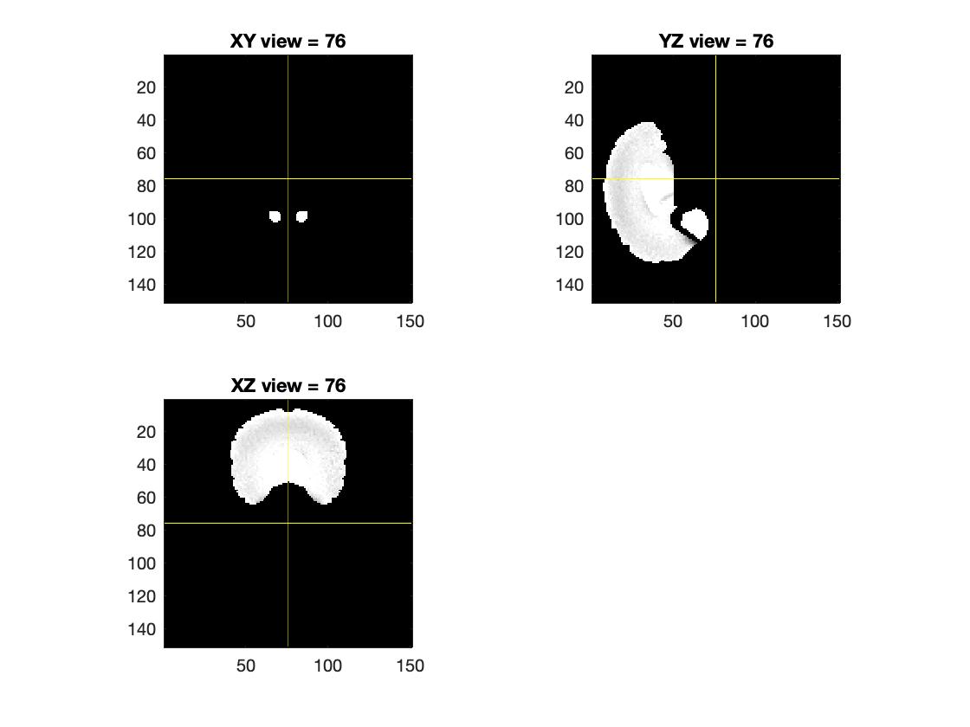
Producing the target field
Best shim value: CoV = 6.4%
Impractical loop current: 2,036 A
Notes:
|H1+| is shown in entire brainLatVent mask, but CoV is calculated just from obs points in cerebrum subvolume.
fitDipoles2targetThresh0_magH1plus_20200401.jpg

Slide 15
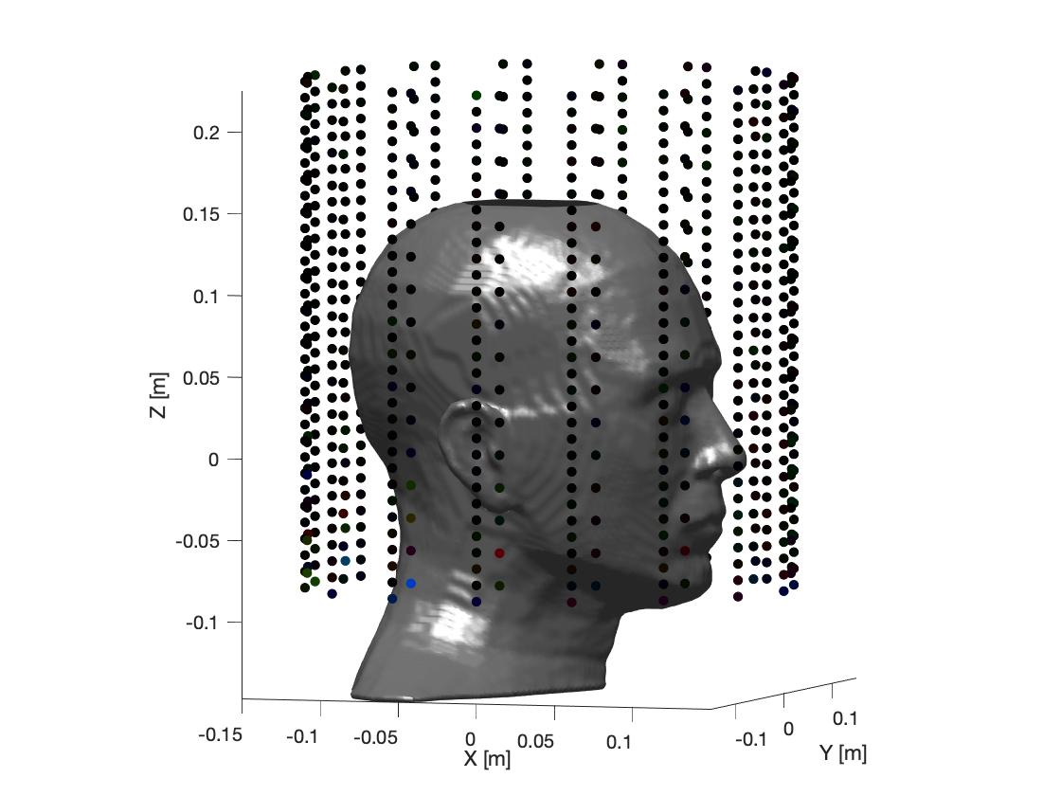
Producing the target field
Best shim value: CoV = 6.4%
Impractical loop current: 2,036 A
Notes:
|H1+| is shown in entire brainLatVent mask, but CoV is calculated just from obs points in cerebrum subvolume.
Multiply ‘dipole amplitude’ by 1.34 to convert to Amps (for a 1 cm radius loop).
fitDipoles2targetThresh0_magH1plus_20200401.jpg

Slide 16
Producing the target field
Best shim value: CoV = 6.4%
Impractical loop current: 2,036 A
Largest currents near lowest ring
Notes:
|H1+| is shown in entire brainLatVent mask, but CoV is calculated just from obs points in cerebrum subvolume.
fitDipoles2targetThresh0_magH1plus_20200401.jpg

Slide 17
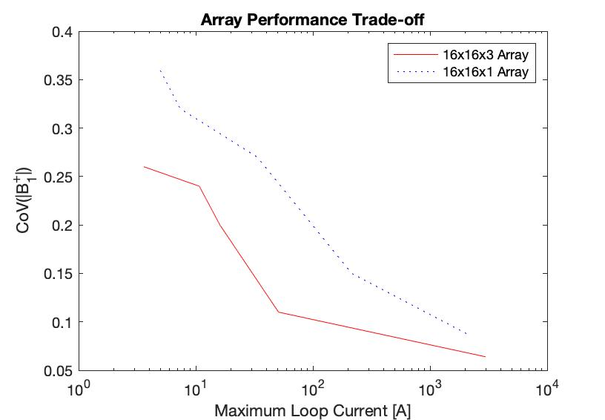
Producing the target field
Best shim value: CoV = 6.4%
Impractical loop current: 2,036 A
Trade-off between max current and field uniformity
Conclusion: 16x16 arrays are not capable of producing the target field
Notes:
Plot for both 16x16x3 and 16x16x1 arrays: CoV vs. log(maxCurrent).
plotArrayPerfTradeoff.m figure.

Slide 18
Producing the target field
Next step:
Increase array size to 16x32
One vs. three loop orientations
Can this generate the target field?
Does the traveling wave target field have any advantages over standing wave shimmed fields?
Uniform SAR?
Robustness to changes in head size, etc?
Notes:
For the brain-sized ellipsoid, we know we need 24 columns of loops—16 is not enough.
fitDipoles2targetThresh0_magH1plus_20200401.jpg

