Slide 1
Self-reported Burnout Levels of Certified Child Life Specialists
Present by Jiahe Wang
Instructor: Jessika Boles
CHILL lab

Slide 2
Introduction
Burnout is an ongoing issue in healthcare workers, with few effective interventions identified to date (Hall et al., 2016; Montgomery et al., 2019)
In the era of COVID-19, with increased patient loads and acuities and minimal resources, burnout has increased across healthcare specialties (Sharifi et al., 2019)
However, little has been done to specifically explore the prevalence and severity of burnout in Certified Child Life Specialists working during the COVID-19 pandemic
Therefore, the purpose of this study was to explore burnout severity in Certified Child Life Specialists employed in North American children’s hospitals

Slide 3
Research Question
What is the level of burnout reported by working Certified Child Life Specialists in pediatric healthcare settings?

Slide 4
Methods
Data were drawn from a larger study surrounding barriers to and predictors of workplace wellbeing for Certified Child Life Specialists and aspiring child life students, with respect to:
Engagement
Burnout
Achievement orientation

Slide 5
Methods
Prospective Online Survey and Questionnaire
Participants
Analysis
Results
Discussion

Slide 6
Prospective Online Survey and Questionnaire
Maslach Burnout Inventory for Healthcare Professionals (MB1 – 4th Edition)
21 Likert-type scale items across three burnout domains
Emotional exhaustion
Depersonalization
Personal accomplishment

Slide 7
Maslach Burnout Inventory for Healthcare Professionals – Sample Questions
I feel emotionally drained from my work.
Working with people all day is really a strain for me.
I have accomplished many worthwhile things in this job.
I feel exhilarated after working closely with my patients.
Never
A few times a year or less
Once a month or less
A few times a month
Once a week
A few times a week
Every day

Slide 8
Participants
Inclusion criteria:
Currently employed as a Certified Child Life Specialist in North America
Speaks English as their primary language (due to limitations of MBI)

Slide 9
Demographic information
Gender
Age
Race
Education Degree Level
Years of Paid Experience
Type of Healthcare Insitution
Work Settings

Slide 10
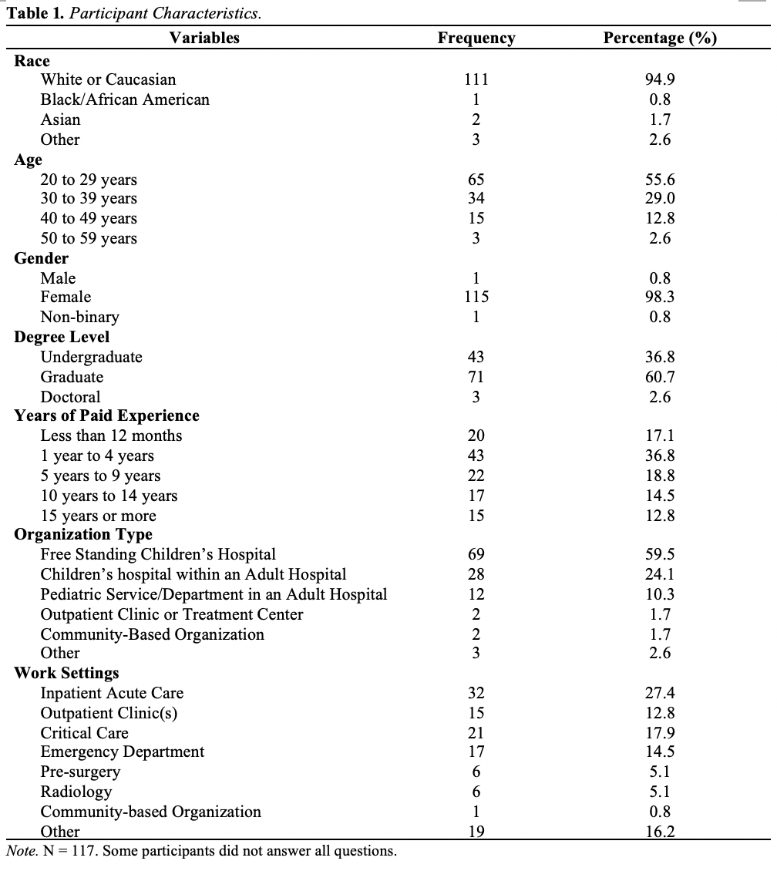
Demographic Information

Slide 11
Gender
Notes:
This is representative of current state of child life field

Slide 12
Age
Notes:
This is representative of current state of child life field

Slide 13
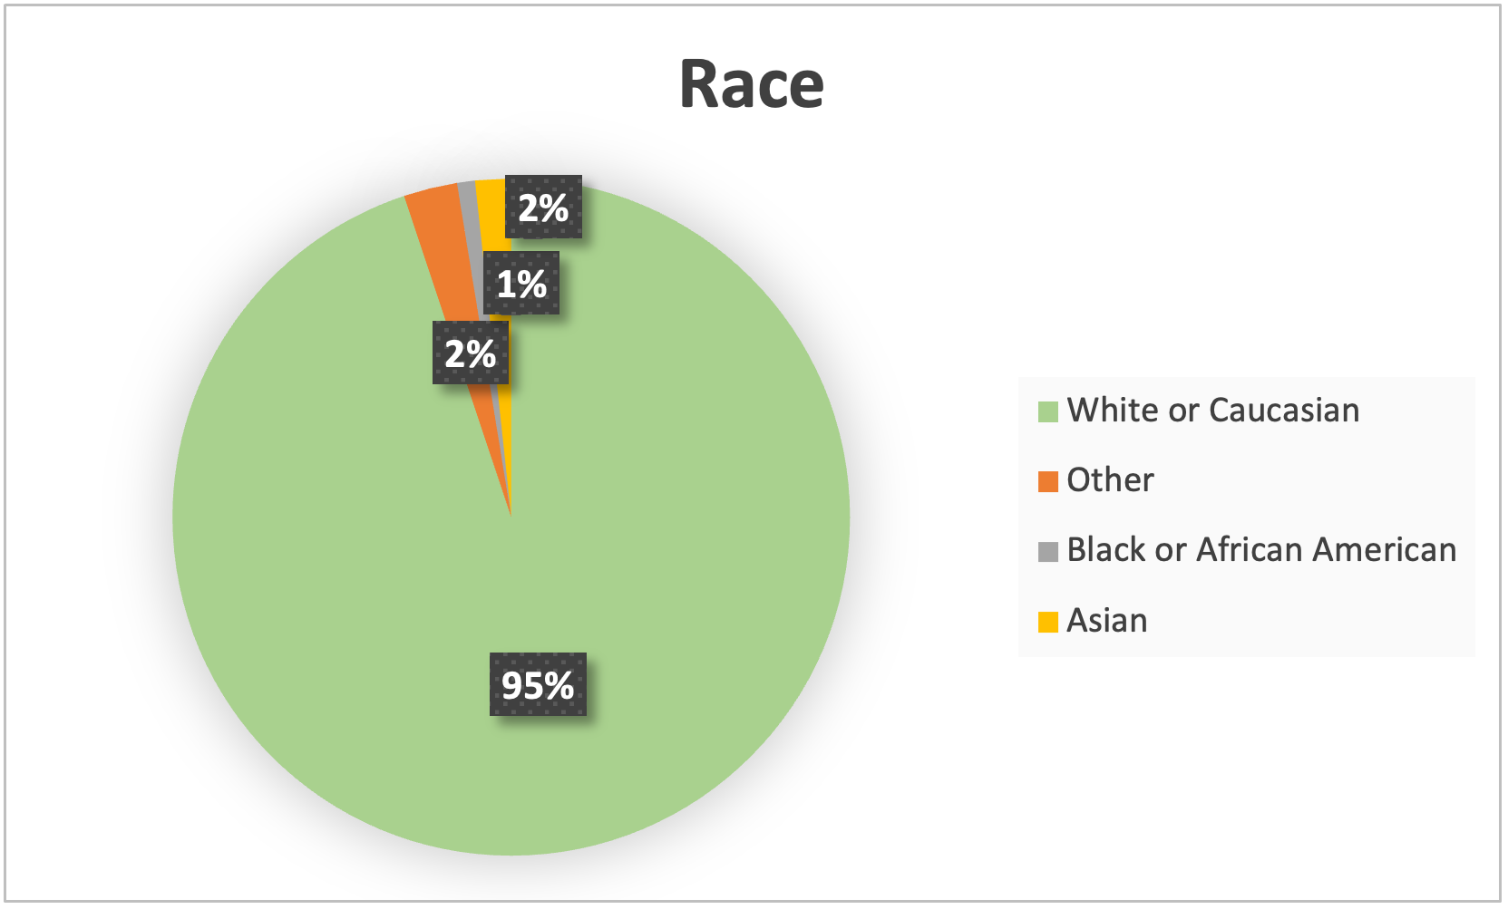
Race
Notes:
This is representative of current state of child life field

Slide 14
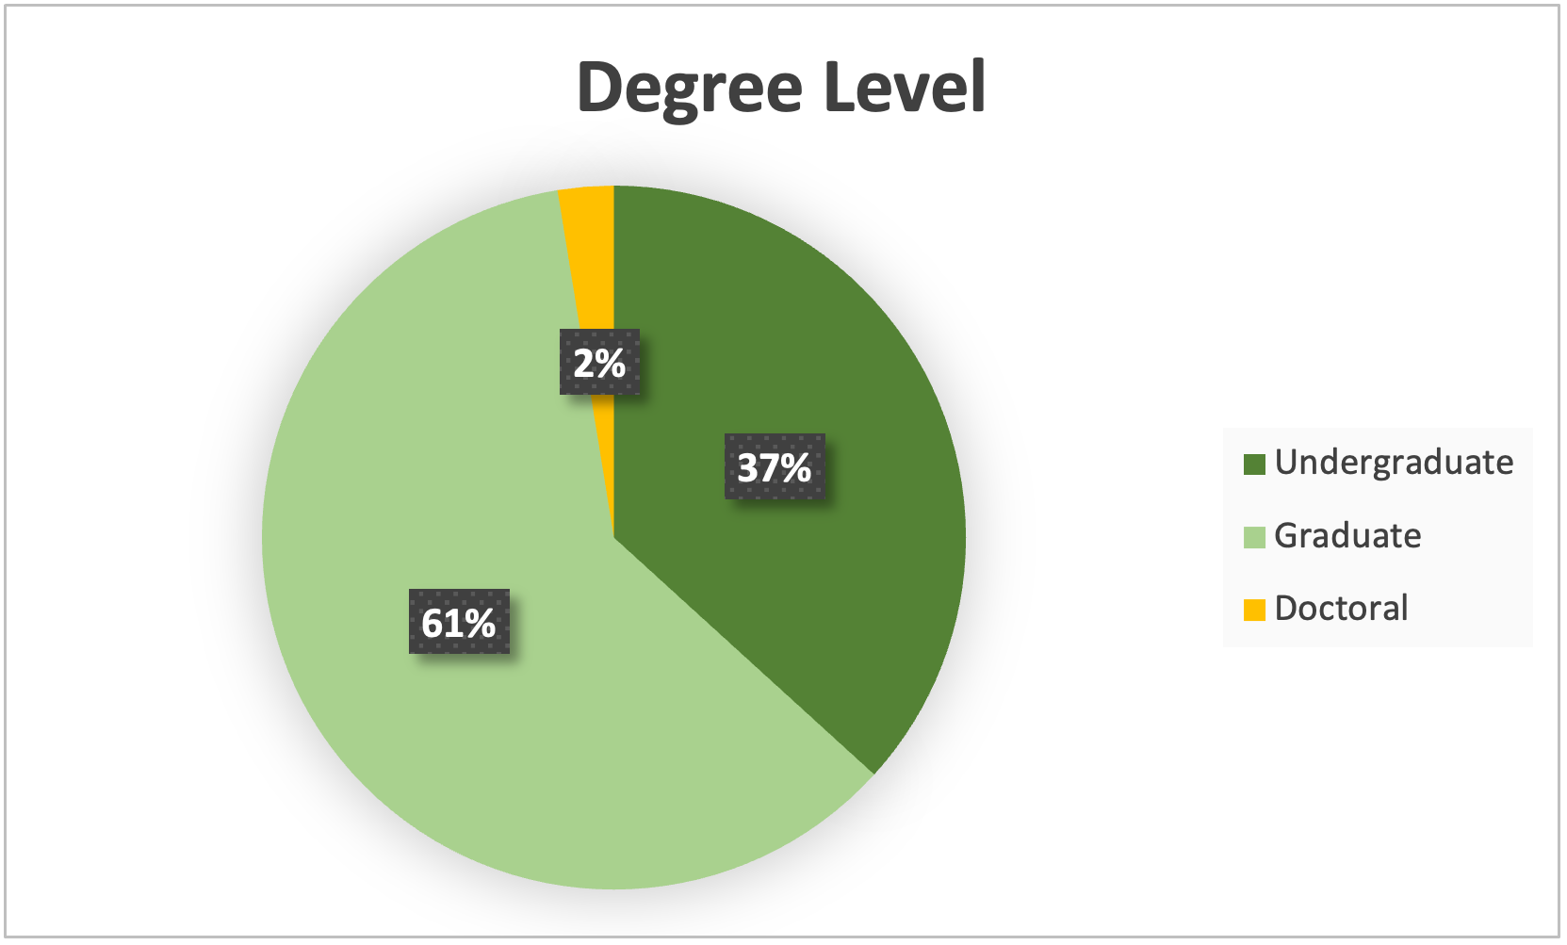
Education Degree Level

Slide 15
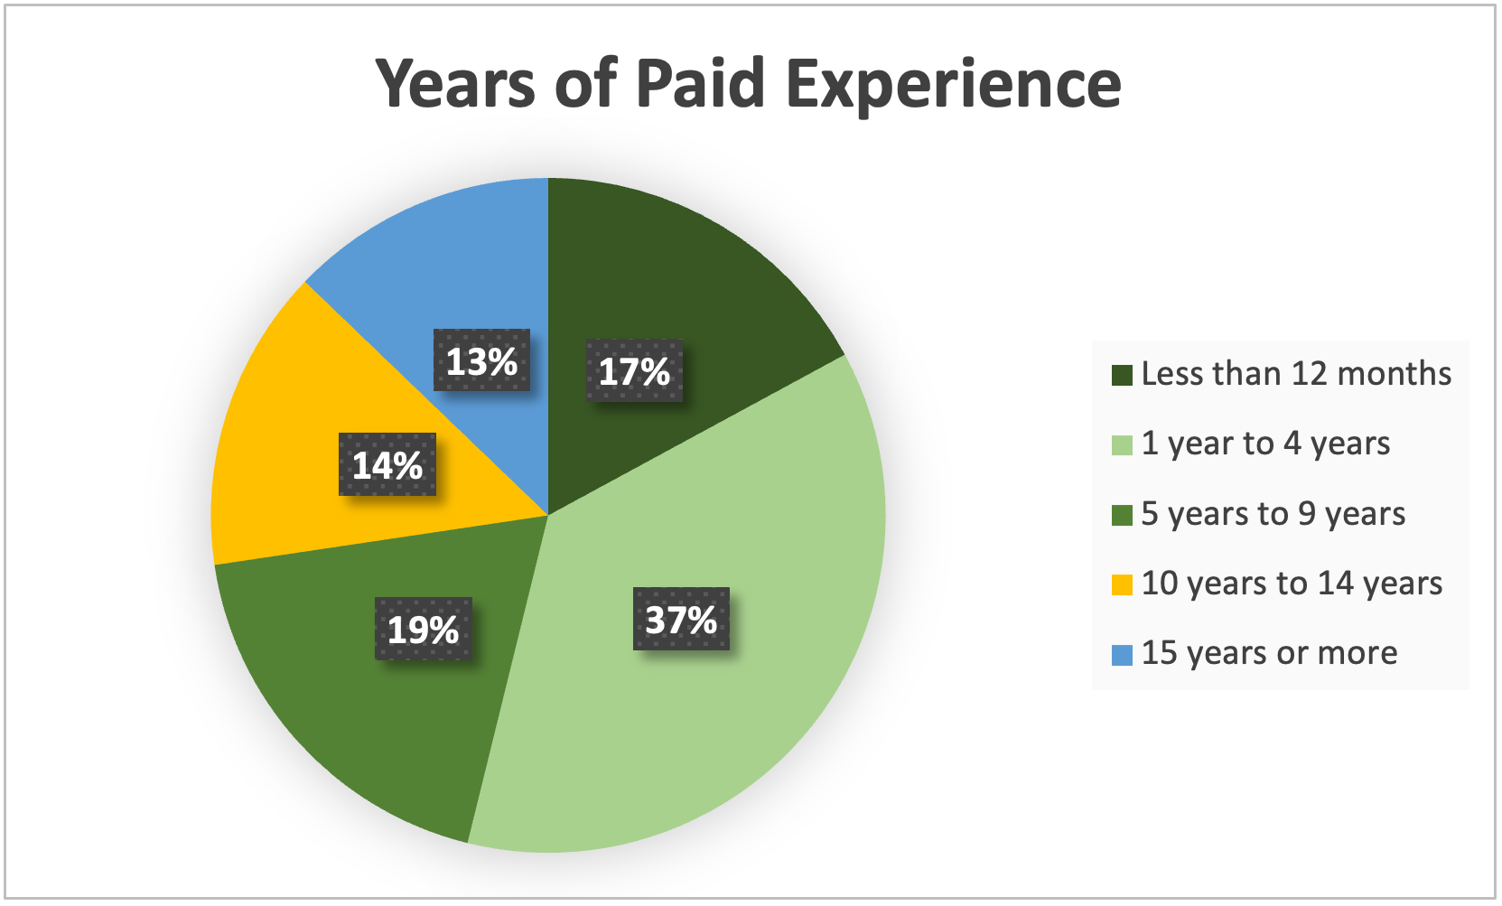
Years of Paid Experience
Notes:
This is representative of current state of child life field

Slide 16
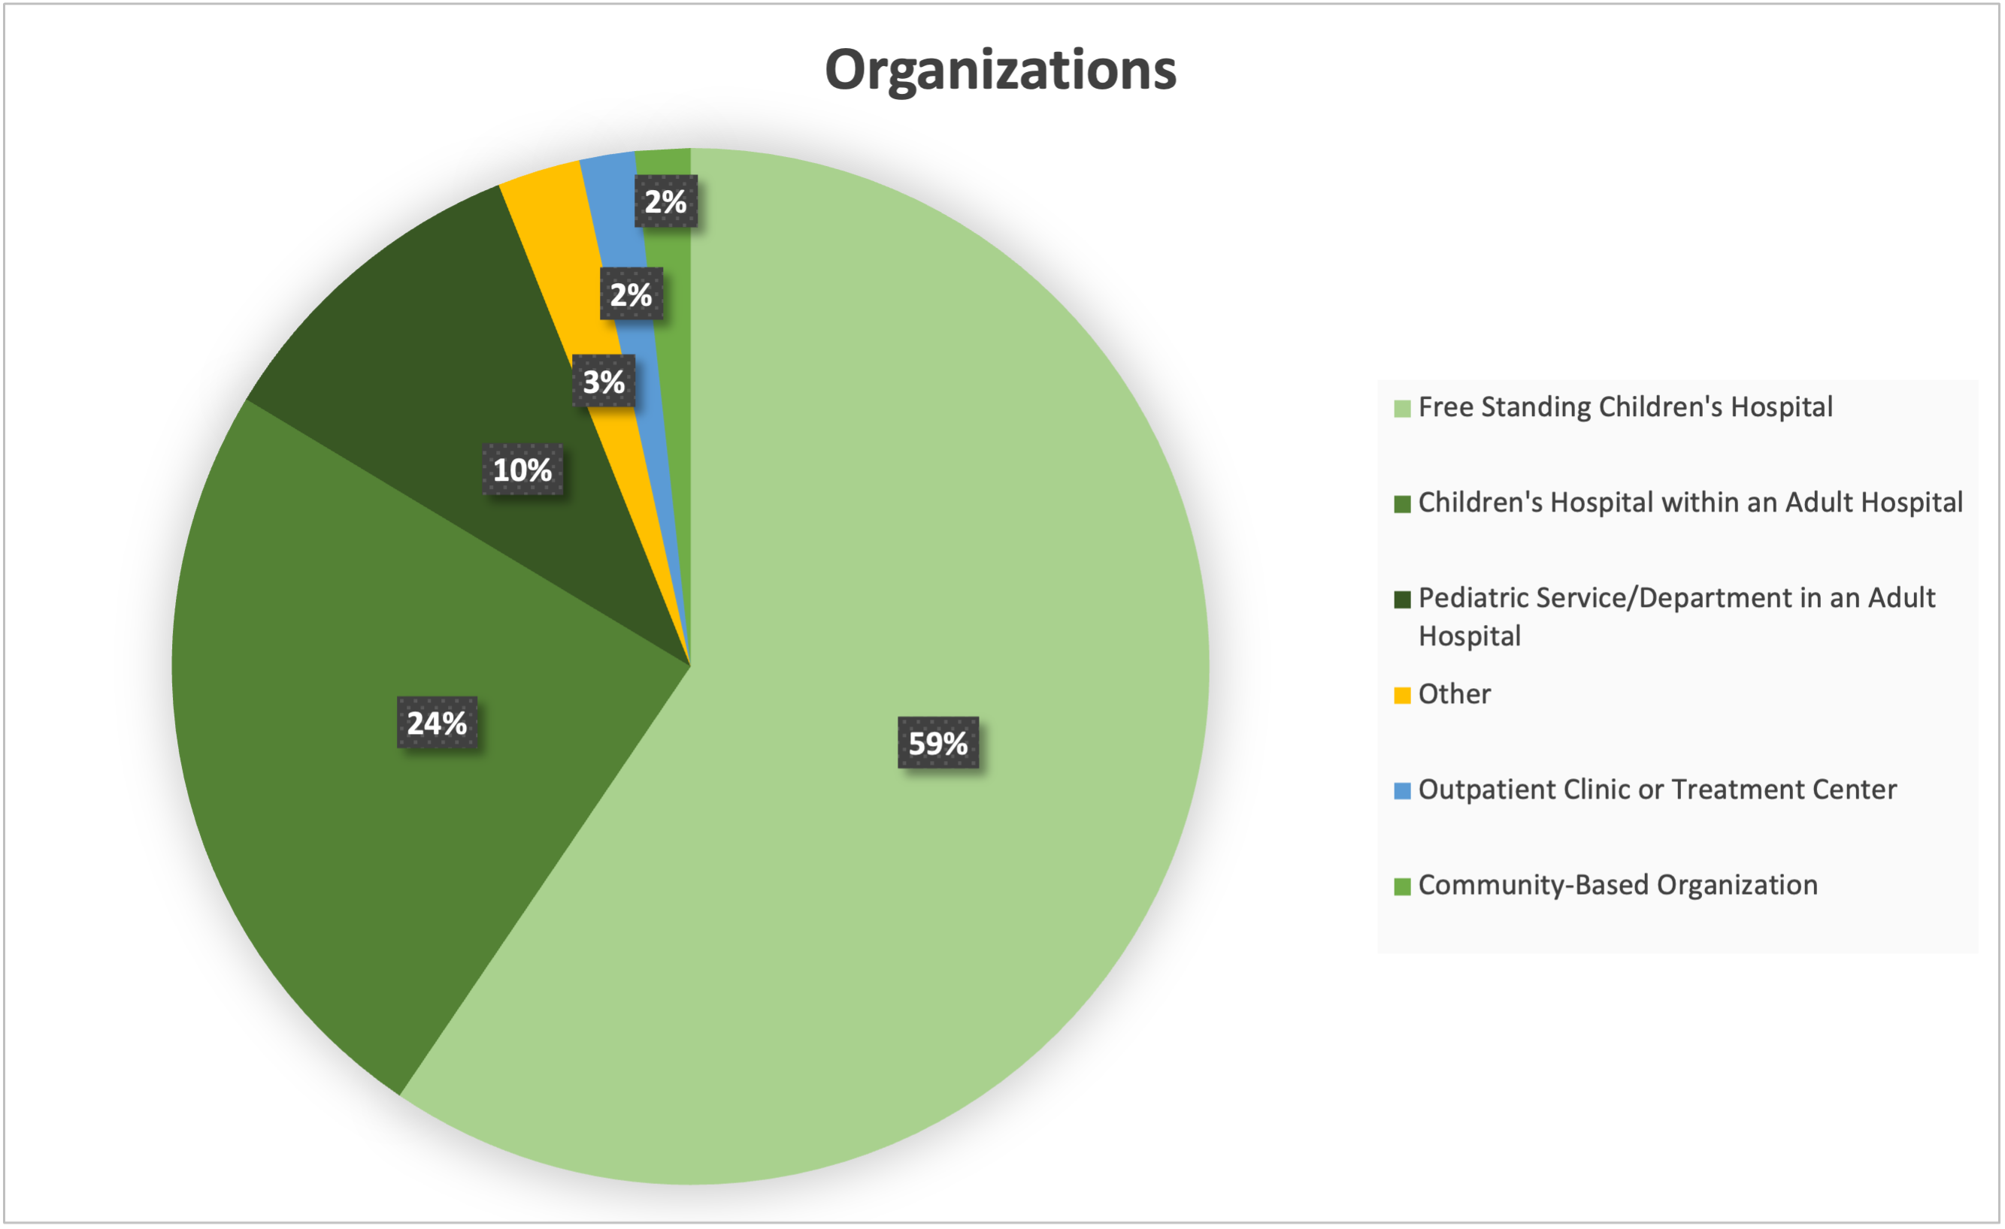
Organizations
Notes:
This is representative of current state of child life field

Slide 17
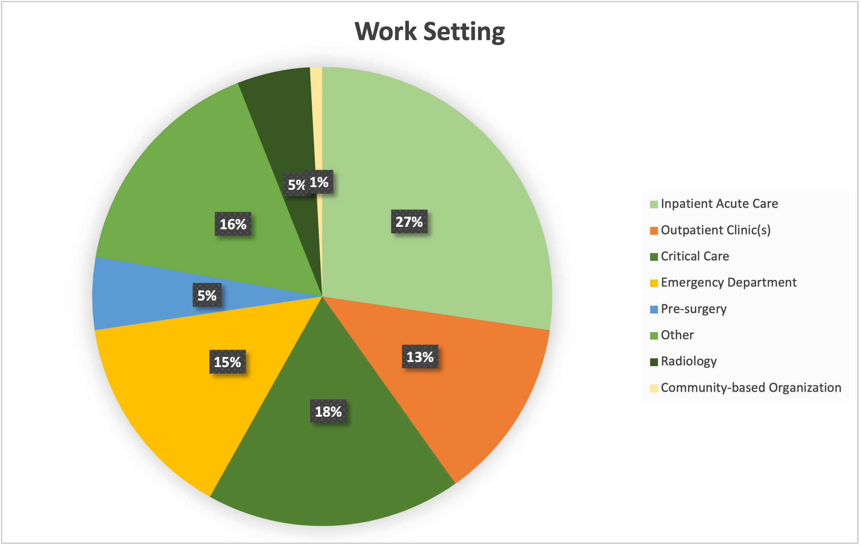
Work Settings
Notes:
This is representative of current state of child life field

Slide 18
Analyses
Descriptive analyses were conducted in SPSS to assess the demographic and work characteristics of the study sample, as well as individual-item and total scores on the MBI-4
Due to ongoing data collection, and some abnormal distributions, regression modeling will be conducted later to understand the predictive value of demographic and work characteristics on MBI-4 scores

Slide 19
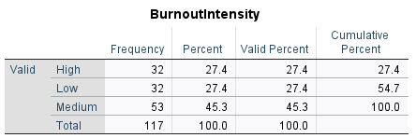
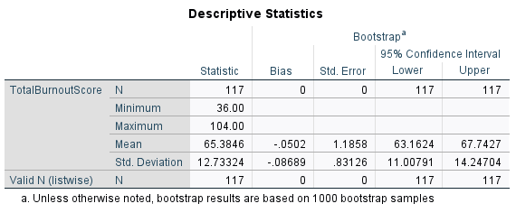
Results
Cumulative burnout scores ranged from 36 to 104, with a score of >56 indicative of moderate burnout, and a score of >75 corresponding with high burnout
Burnout severity appears to be normally distributed, with 72.% scoring as moderate or high

Slide 20
Discussion and Conclusions
Certified Child Life Specialists in this study report a range of burnout scores, which cannot yet be predicted by demographic factors such as years of paid work experience, education level, annual salary, institution type, or work setting
However, this is the first study to document rates of burnout in this population
Effective intervention tactics should assume sizable risk of burnout in all Certified Child Life Specialists, and prioritize preventative approaches rather than reactive efforts
Future studies are needed to assess the contributions of demographic and workplace factors in burnout scoring and severity

