Slide 1
Preliminary Experimental Results and Experimental Methods for Mercury Contaminated OPC Testing: EPA Methods 1313 and 1315
Laira Kelley, Andrew C. Garrabrants, Rossane DeLapp, David S. Kosson
Vanderbilt University
Nashville, Tennessee, USA
November 3rd, 2021

Slide 2
Project Goal and Objectives
Goal: Propose and conduct experimentation for testing of mercury-impacted OPC materials using Method 1313 and Method 1315.
Objective 1: To outline the findings of method development testing, giving guidance to what preservation methods need to be used, as well as filtration techniques and preparation and storage of samples throughout experimentation.
Objective 2: To outline the methodology for Method 1313 and Method 1315 so that procedures reflect the findings of preliminary testing and are adapted to address the preservation of mercury-contaminated material.

Slide 3
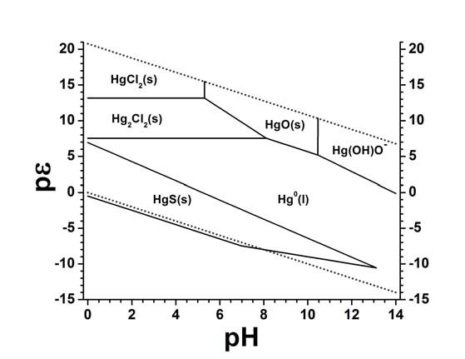
Behavior of Mercury
Elemental Mercury (Hg(0))
Liquid at room temperature
Vapor Pressure of 0.17 Pa at 20°C
Solubility of 60 µg/L in water
Easily volatilized
Forms amalgams with other metals, salts, and organic compounds
Compounds of interest include HgCl₂ and HgS
HgCl₂ solubility of 69 g/L (very soluble in water)
HgS solubility of 2E-53 g/L
Hg solid phases in contact with aqueous solution with Cl⁻ and SO₄²⁻ (10⁻³ mol/kg; 1 bar)

Slide 4
Material Compatibility
Interactions with HDPE, LDPE, Nylon, and Polypropylene
Linked to mercury sorption from low-level solutions (<1 mg/L)
Reported losses of up to 43% in HDPE digitubes (Zhang, 2020)
LDPE bags reported concentration of Hg 15% lower than that stored in glass container (Liescheski, 1999)
Nylon is utilized as a sorbent for mercury (Dunham-Cheatham, 2020)
PTFE and Glass Containment
Mercury solutions of 0.003-0.013 µg/L are stable in both PTFE and glass over 13 day period when preserved with HCl (Guevara, 2013)
Use of preservation for samples with glass containment reports no significant losses over several weeks (Zhang, 2020)
HDPE, polypropylene, and nylon should be avoided and replaced with glass or PTFE materials wherever possible.

Slide 5
Stability of Low-Level Mercury Solution in Time-Dependent Leaching Test Eluate
Objective
Quantify losses of mercury from low-level mercury standard stored in borosilicate glass vials with PTFE lid liners over 2-week hold time for Methods 1313 & 1315 (no preservation).
Approach
50 µg/L mercury solution, pH adjusted to ~11
Stored at room temperature
Sampled at 1 week and 2 week
Results
Minimal losses occur in low-level solutions when PTFE and glass are storage materials
% Difference to Standard: 0.6%

Slide 6
Losses of Dissolved Mercury During Filtration of Aqueous Samples
Objective
To evaluate the potential for sorption losses from low-level mercury solutions due to contact with polypropylene housing of PTFE filtration cartridges.
Approach
50 µg/L mercury solution pH adjusted to: ~ 2, 5, 7, 9, 11
Filtered 10-mL aliquots of each pH through glass syringe and PTFE filter cartridges
Unfiltered sample of each pH value
Results
Losses to filtration cartridge occur at a pH>9.0
% Diff to standard for pH 11: 7.6%
% Diff to standard for all other pH: <1.0%

Slide 7
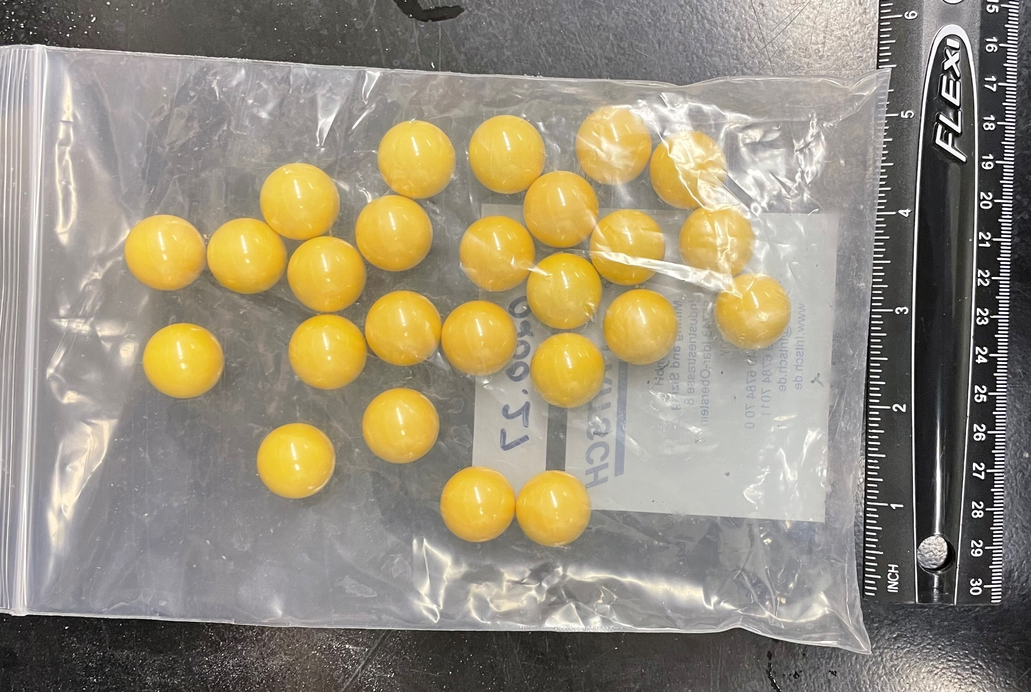
Potential Sorption of Mercury to Milling Media
Objective
To determine if mercury sorption occurs when using magnesium stabilized zirconium milling media and low-level mercury solution.
Approach
50 µg/L mercury solution adjusted to pH ~11
Added one milling ball to solution, 3 replicates and control
Sampled at 30 min, 1 hour, 2 hours
Results
Minimal sorption of aqueous mercury occurs over prolonged contact period
% Diff to Standard: <0.5%

Slide 8
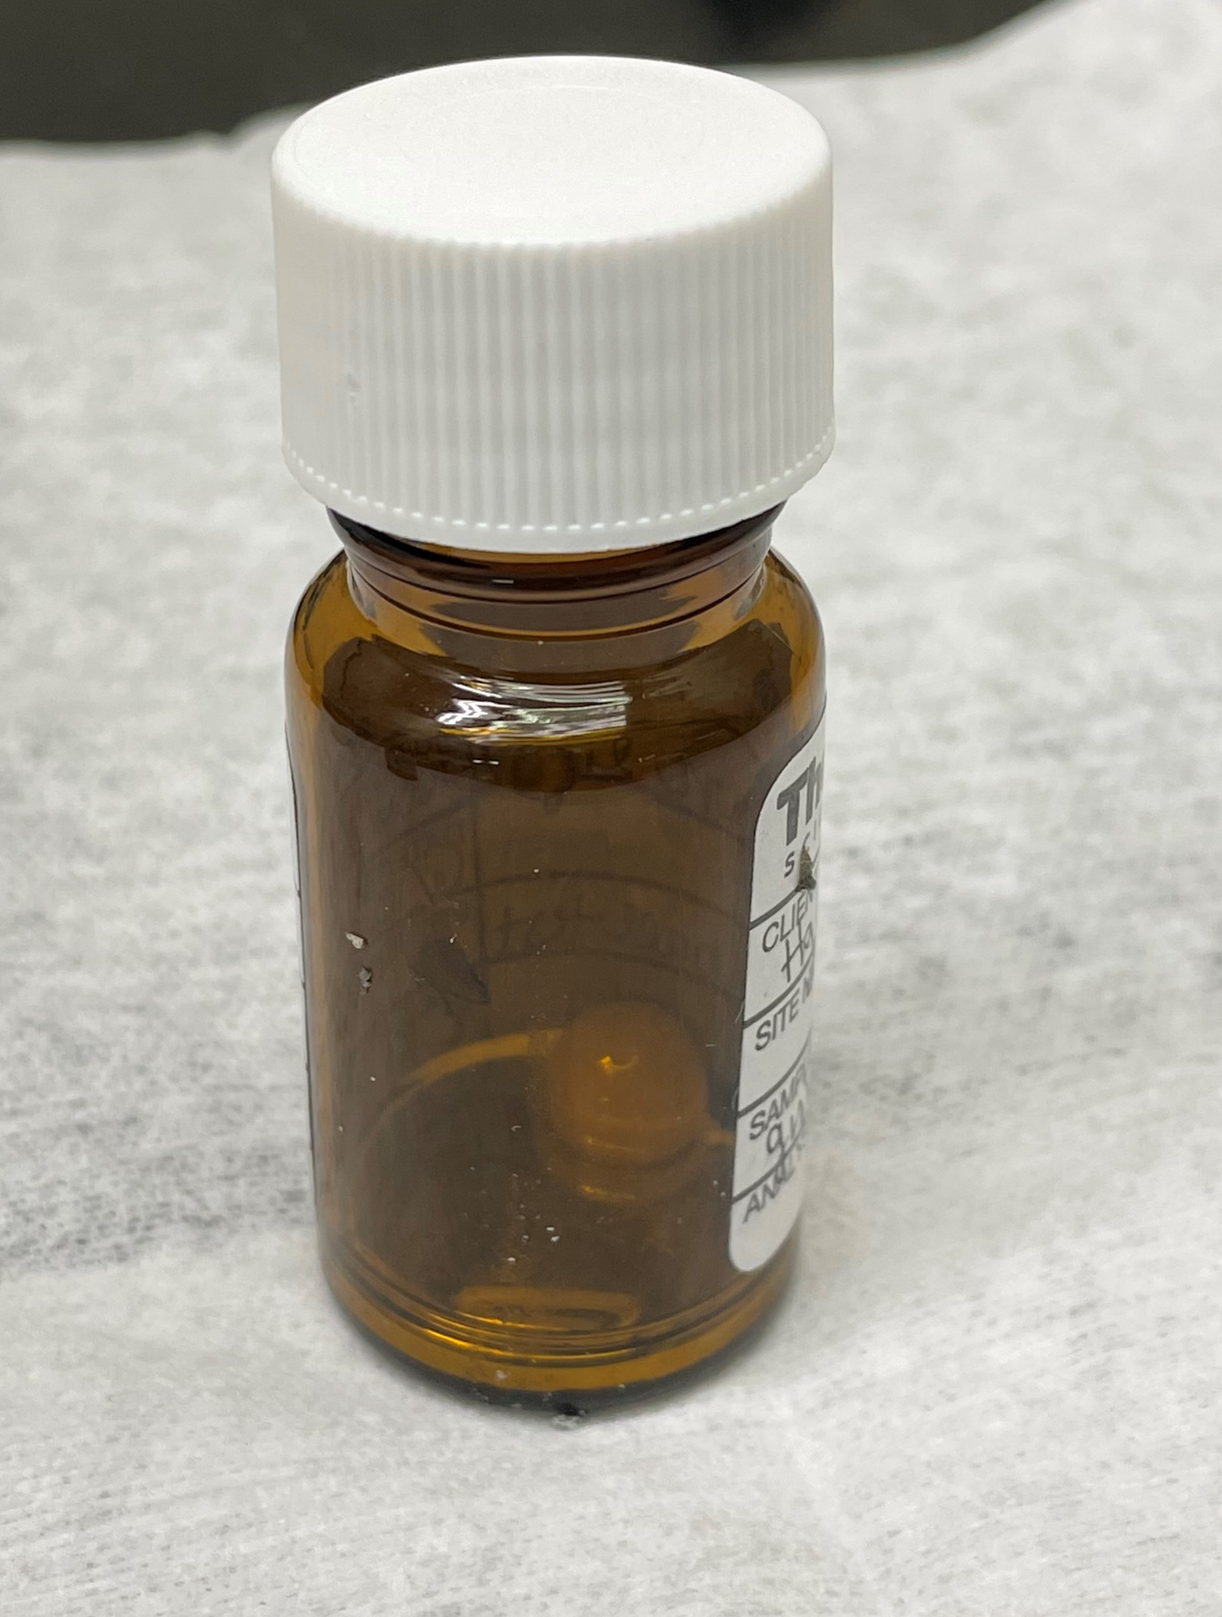
Potential Sorption of Elemental Mercury to Milling Media
Objective
Determine if mercury sorption occurs when using magnesium stabilized zirconium milling media and liquid elemental mercury.
Approach
2 mm height of elemental mercury in glass vial
Milling ball added to vial, no replicates
Rinse ball with DI water after 1 hour of contact
Back Extract milling ball in 2% HCl for 48 hours, 3 repetitions
Results
Sorption occurs, 0.64 mg/L removed from first 48 hour HCl soak
mercury removed from milling surface with HCl soak

Slide 9
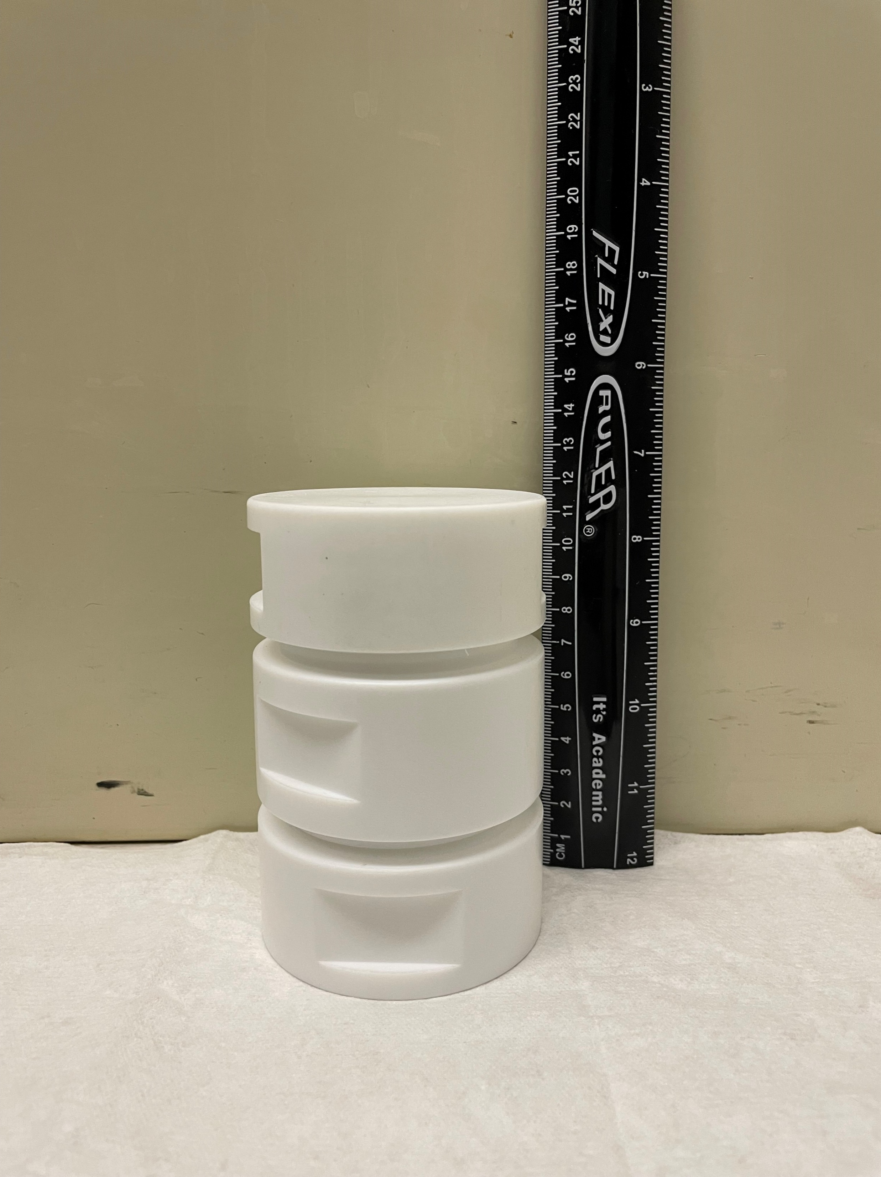
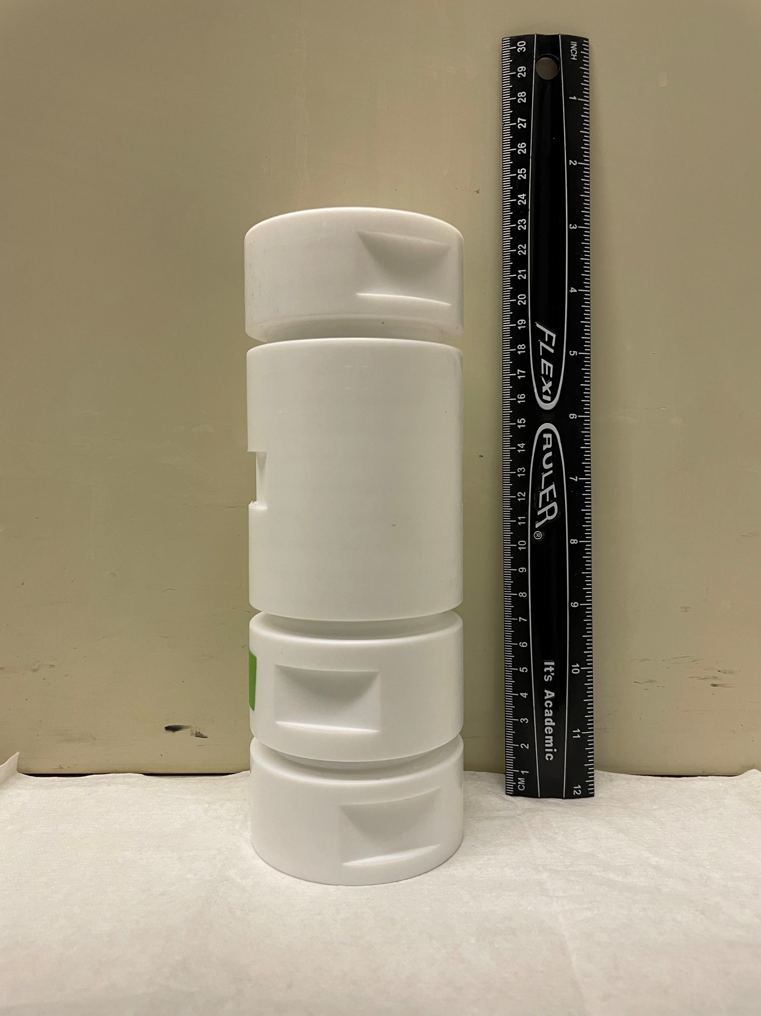
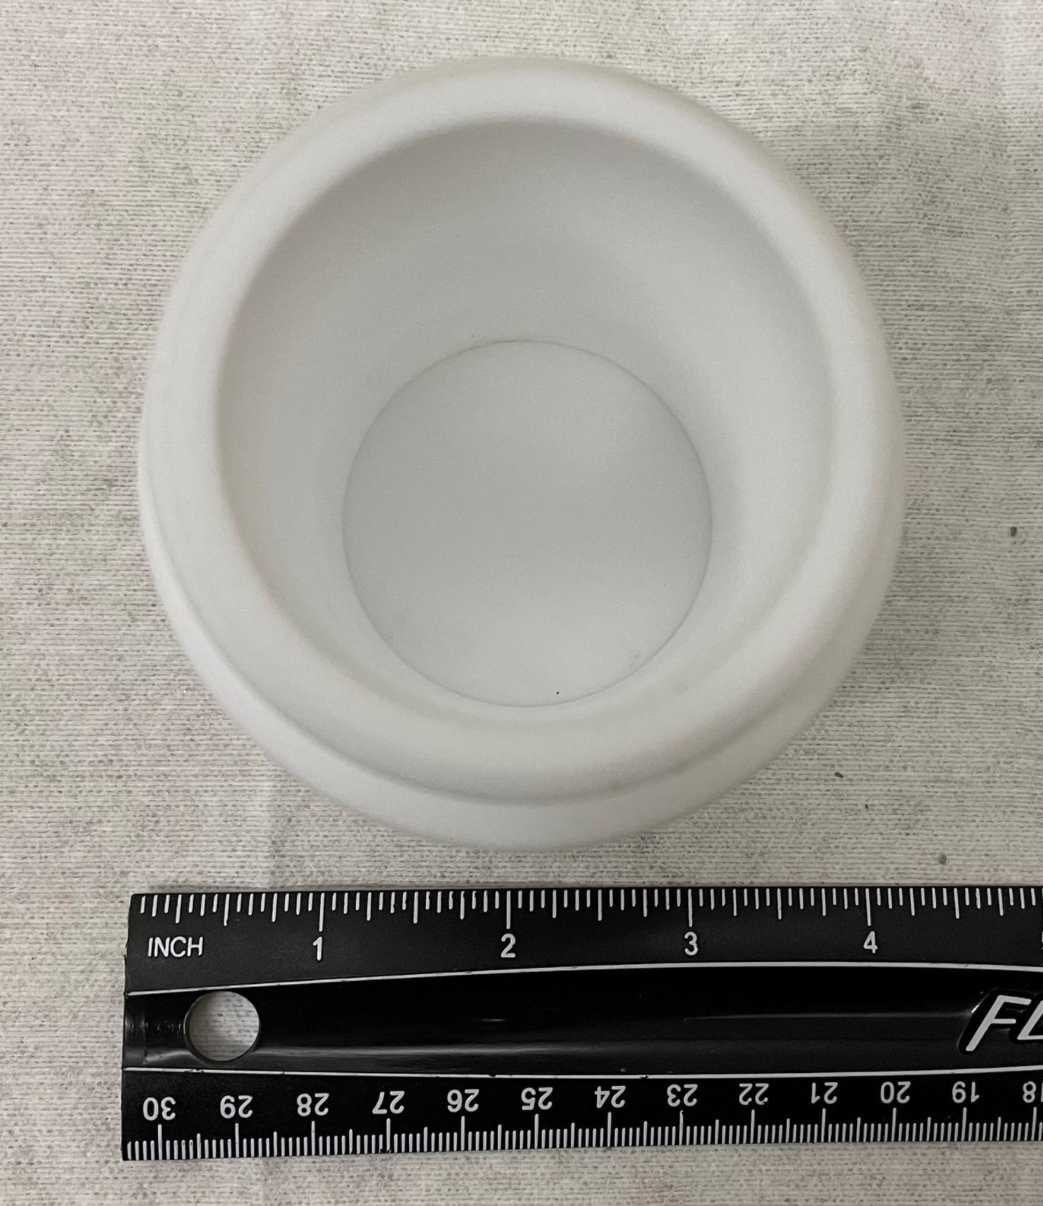
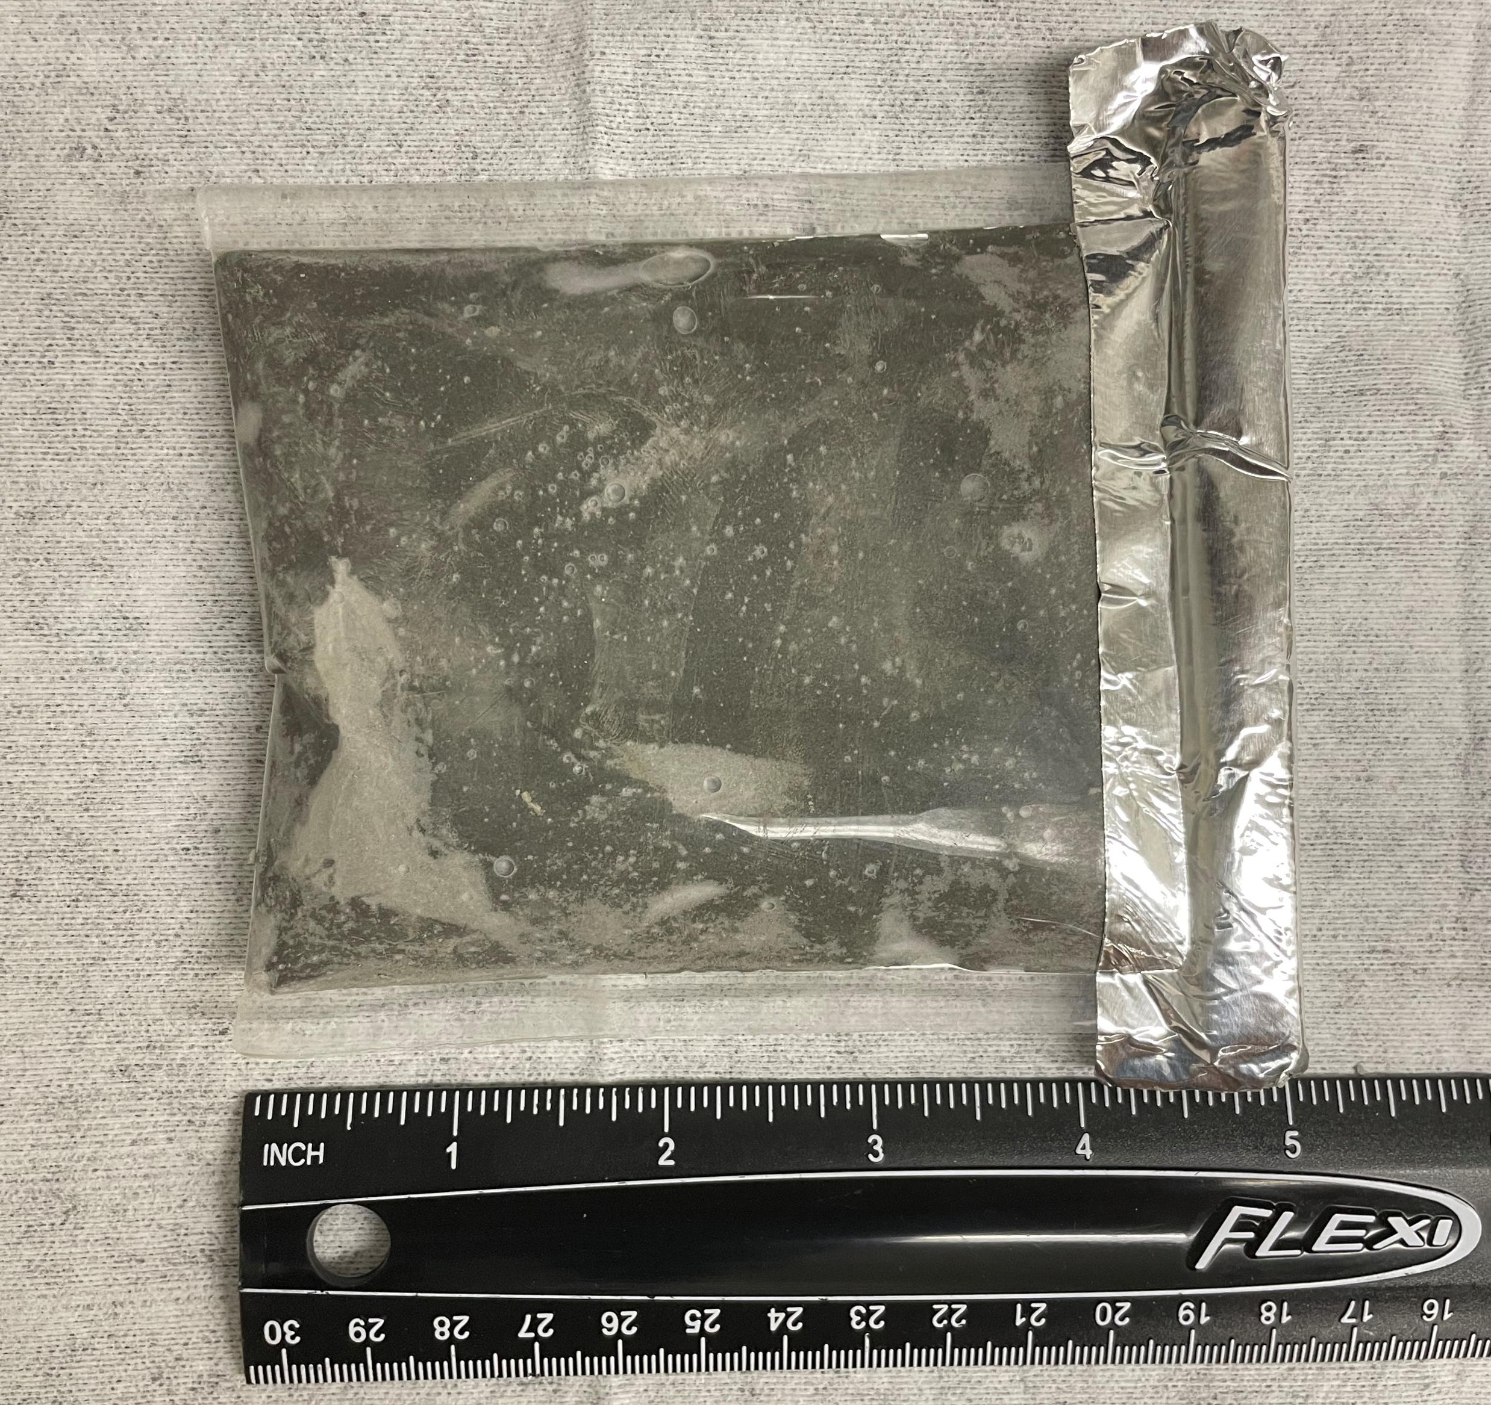
Sample Casting & Method 1315 Testing
Materials for Casting
Cast solid material into specially fabricated PTFE molds fitted with a leaching attachment for EPA Method 1315 1-Dimensional testing
Molds allow for 5-cm diameter by 10-cm length cylinder to be cast, sealed, and cured all within same PTFE containment
Cast flat sheets in PTFE bags for crushing of material for EPA Method 1313 Testing

Slide 10
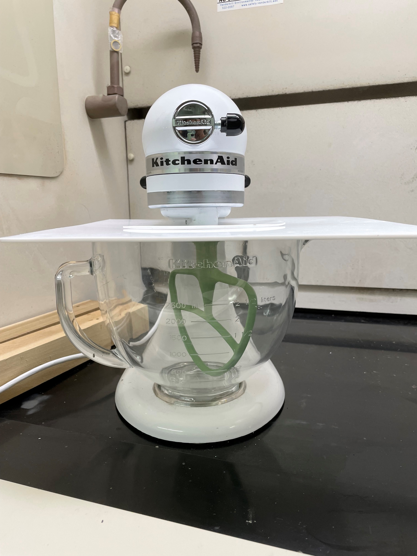
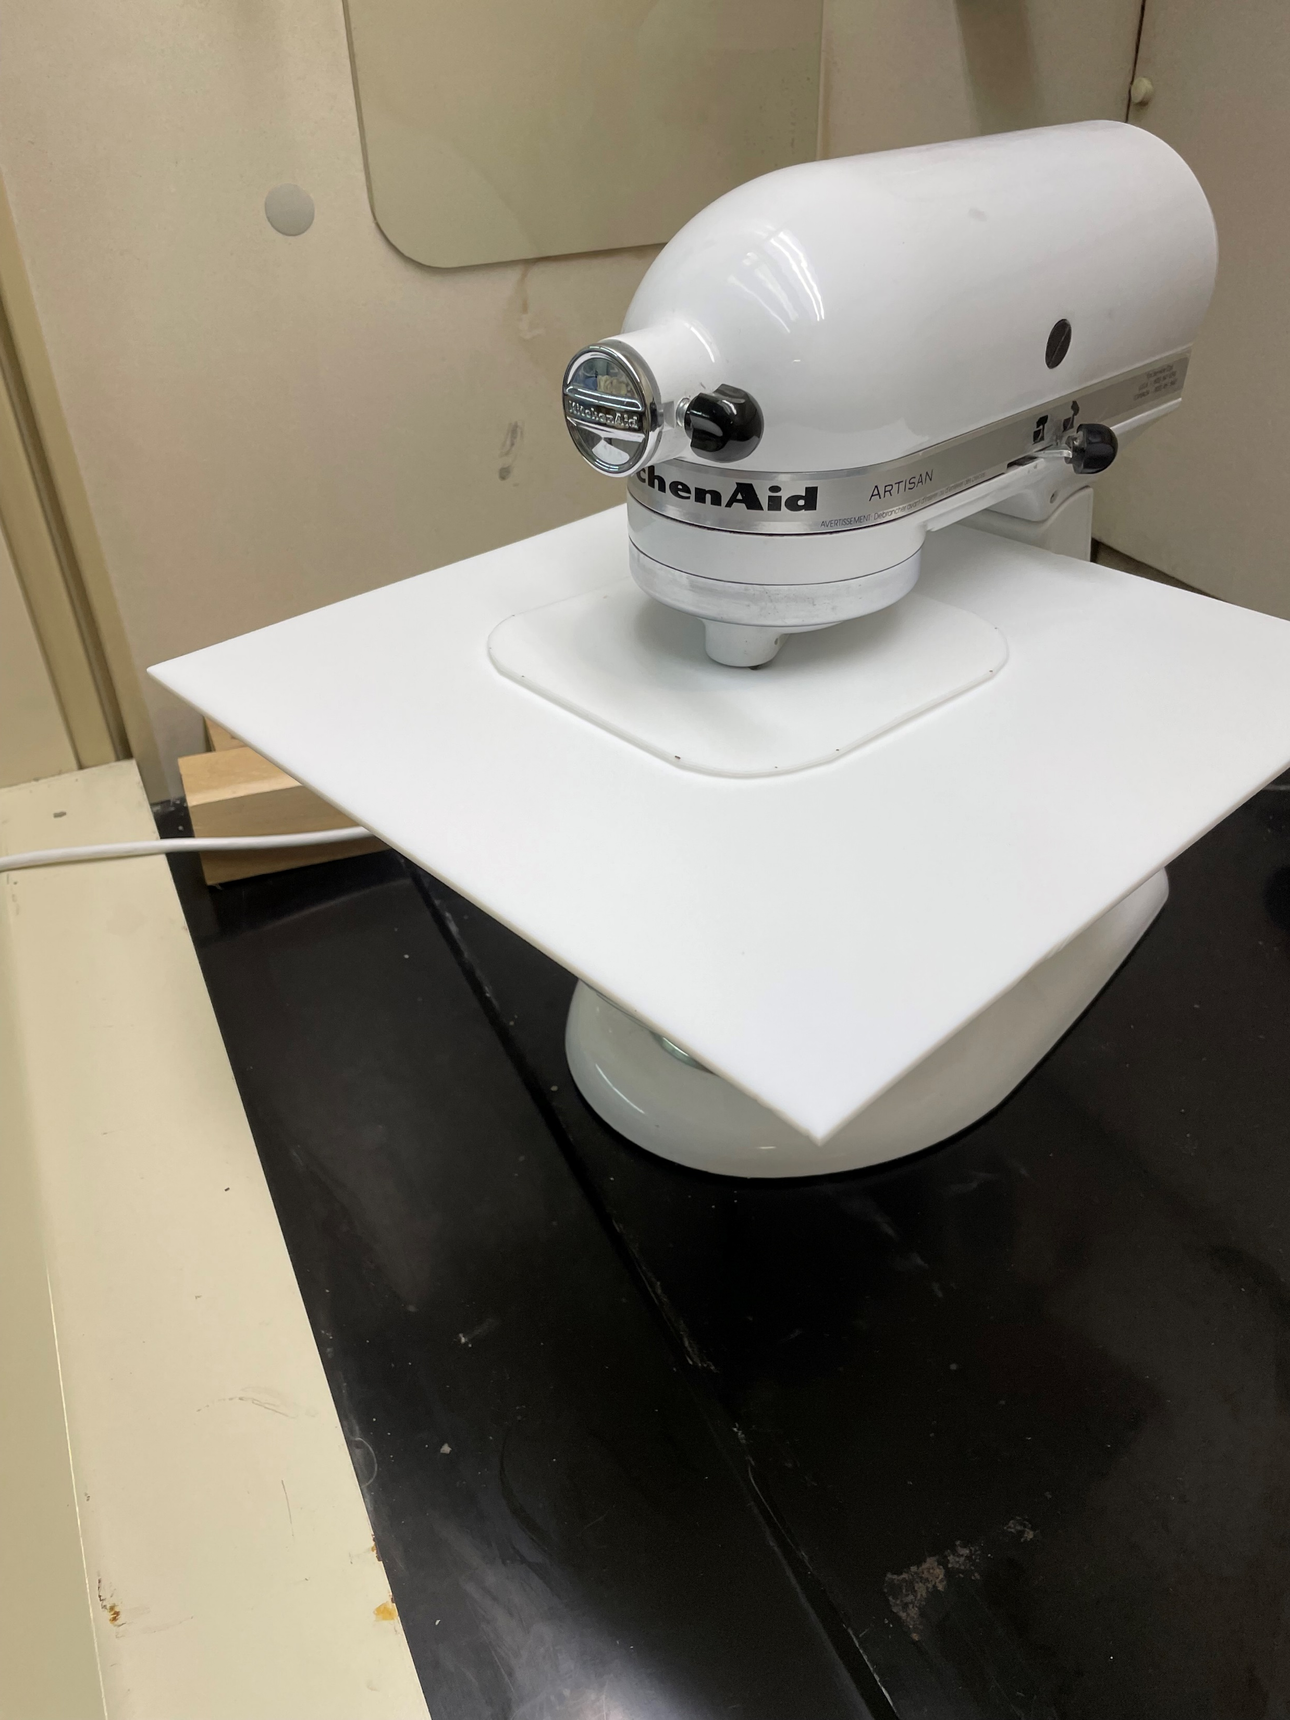
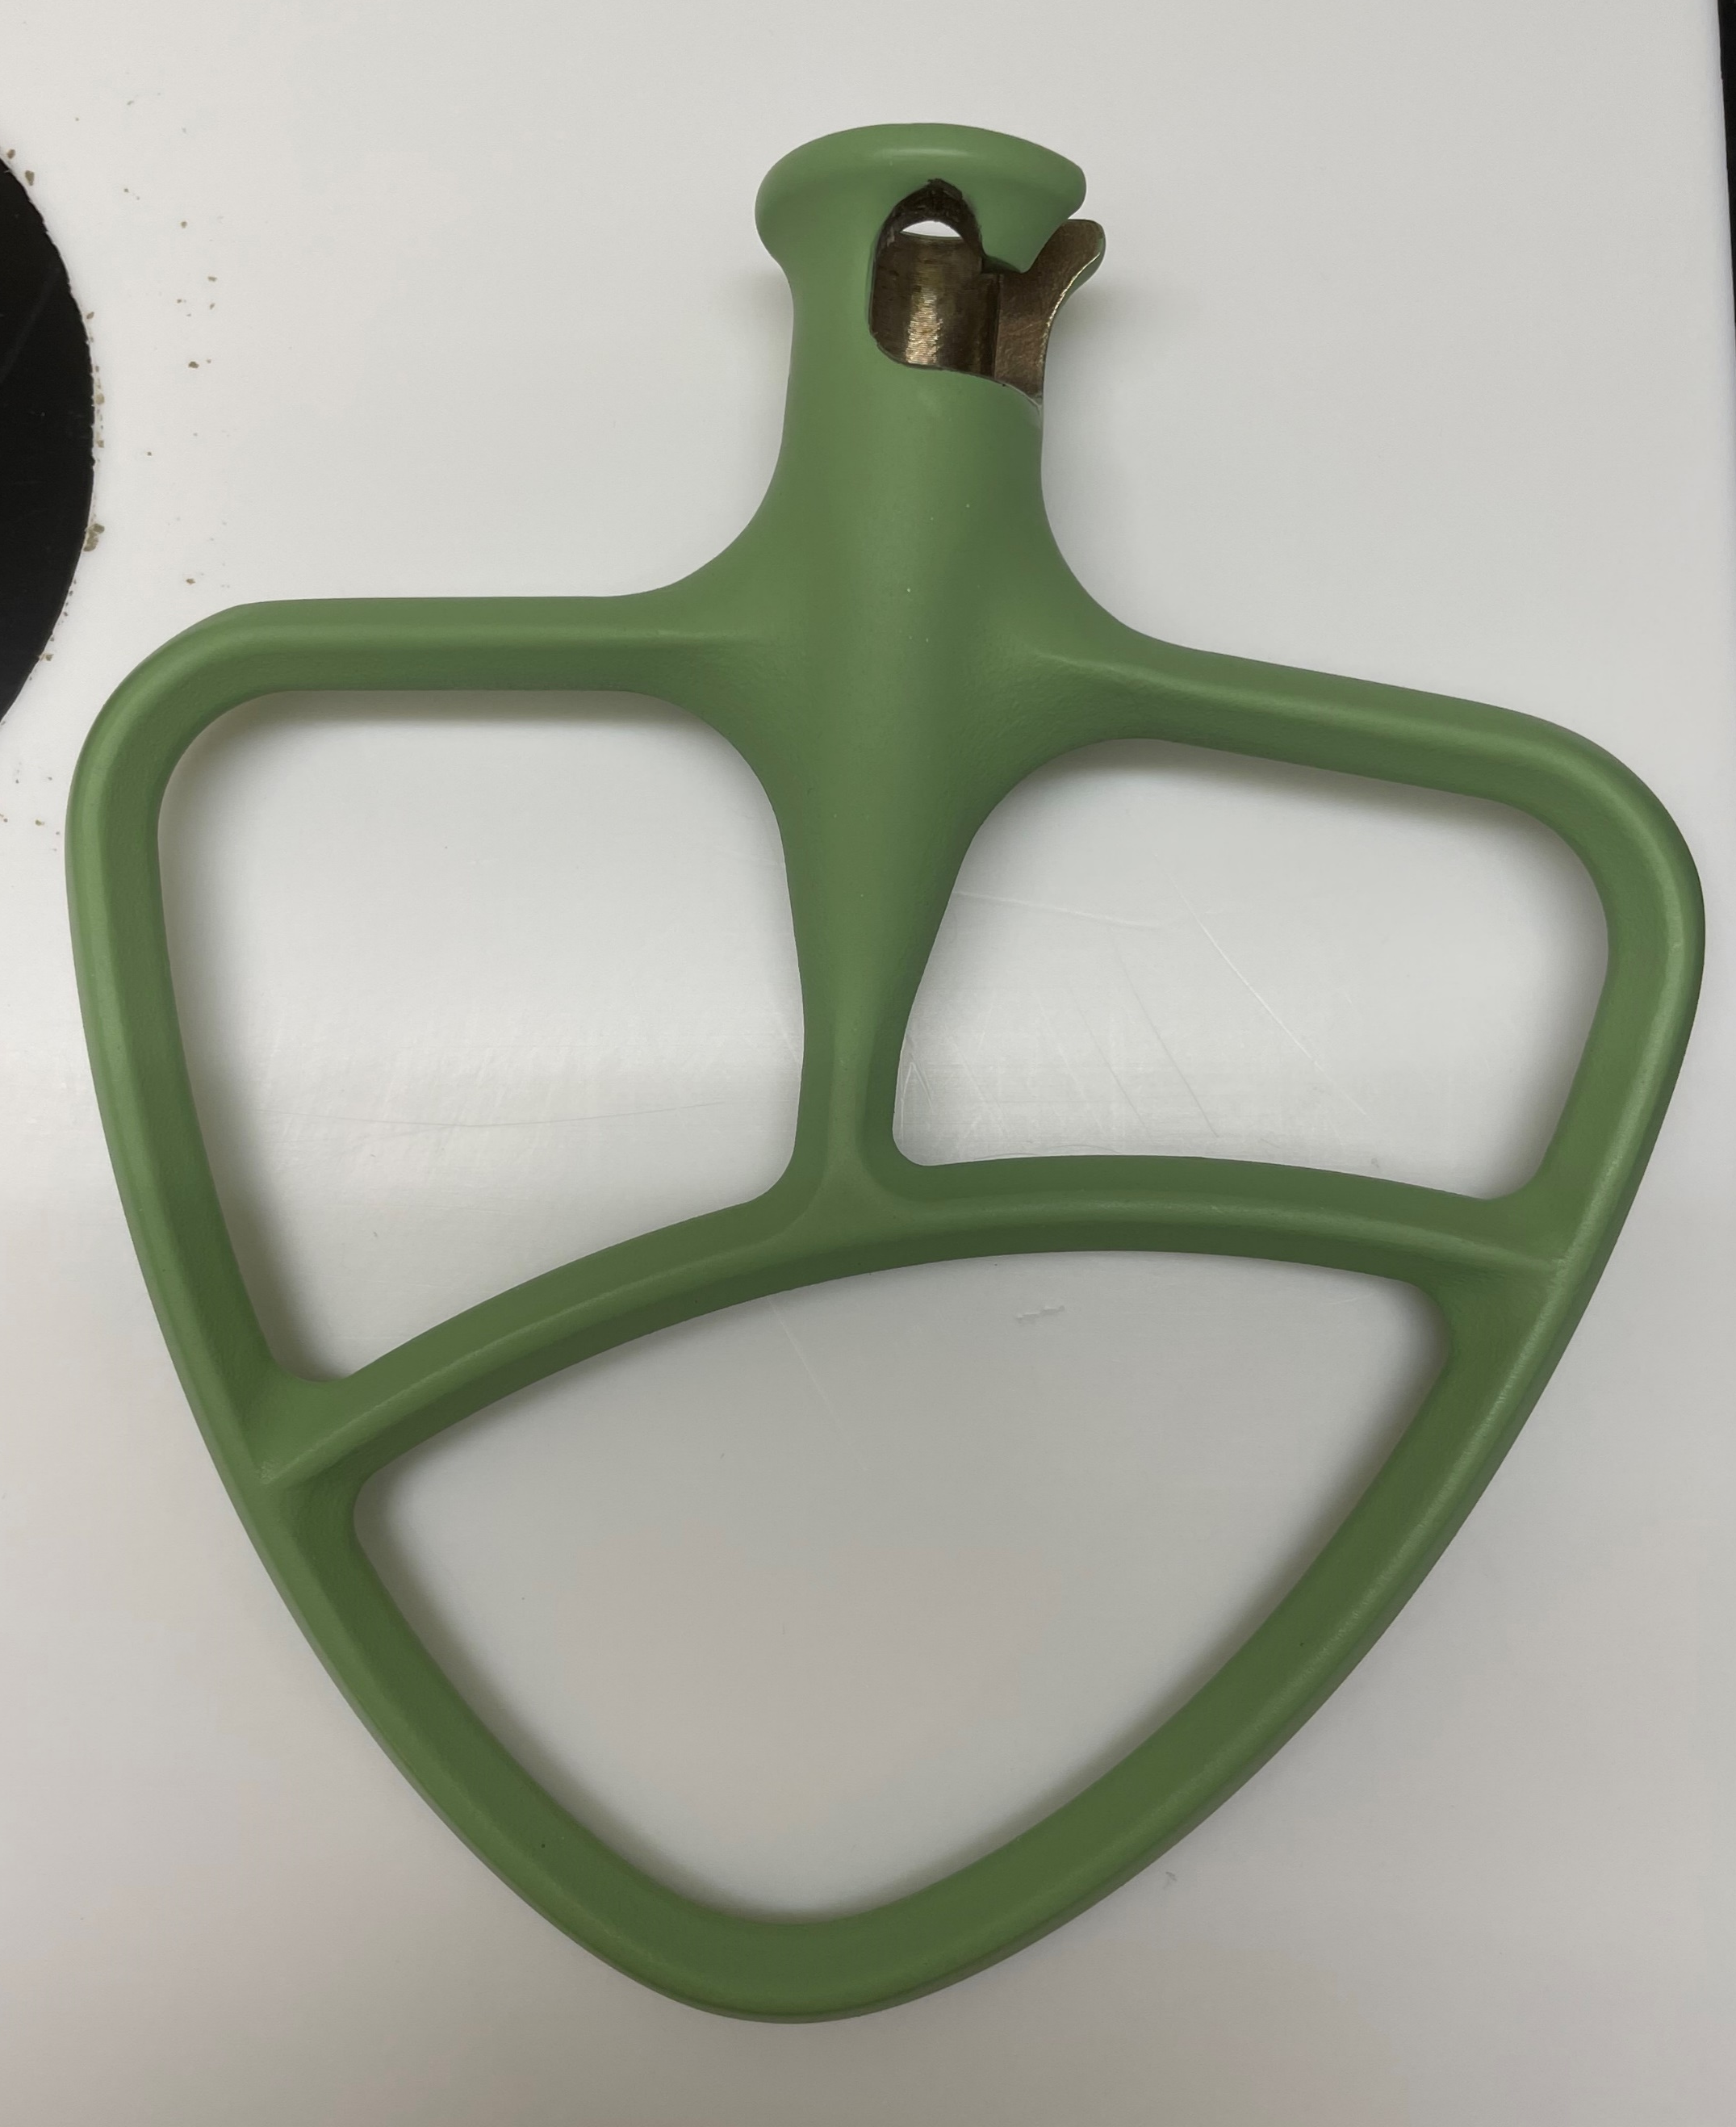
Solid Sample Preparation to Minimize Losses
Casting of Doped OPC
Use stand mixer fitted with glass bowl, specially coated PTFE beater, and PTFE shield to minimize air exposure
Low speed blending of OPC with reagent water followed by direct mercury addition in final minutes of blending

Slide 11
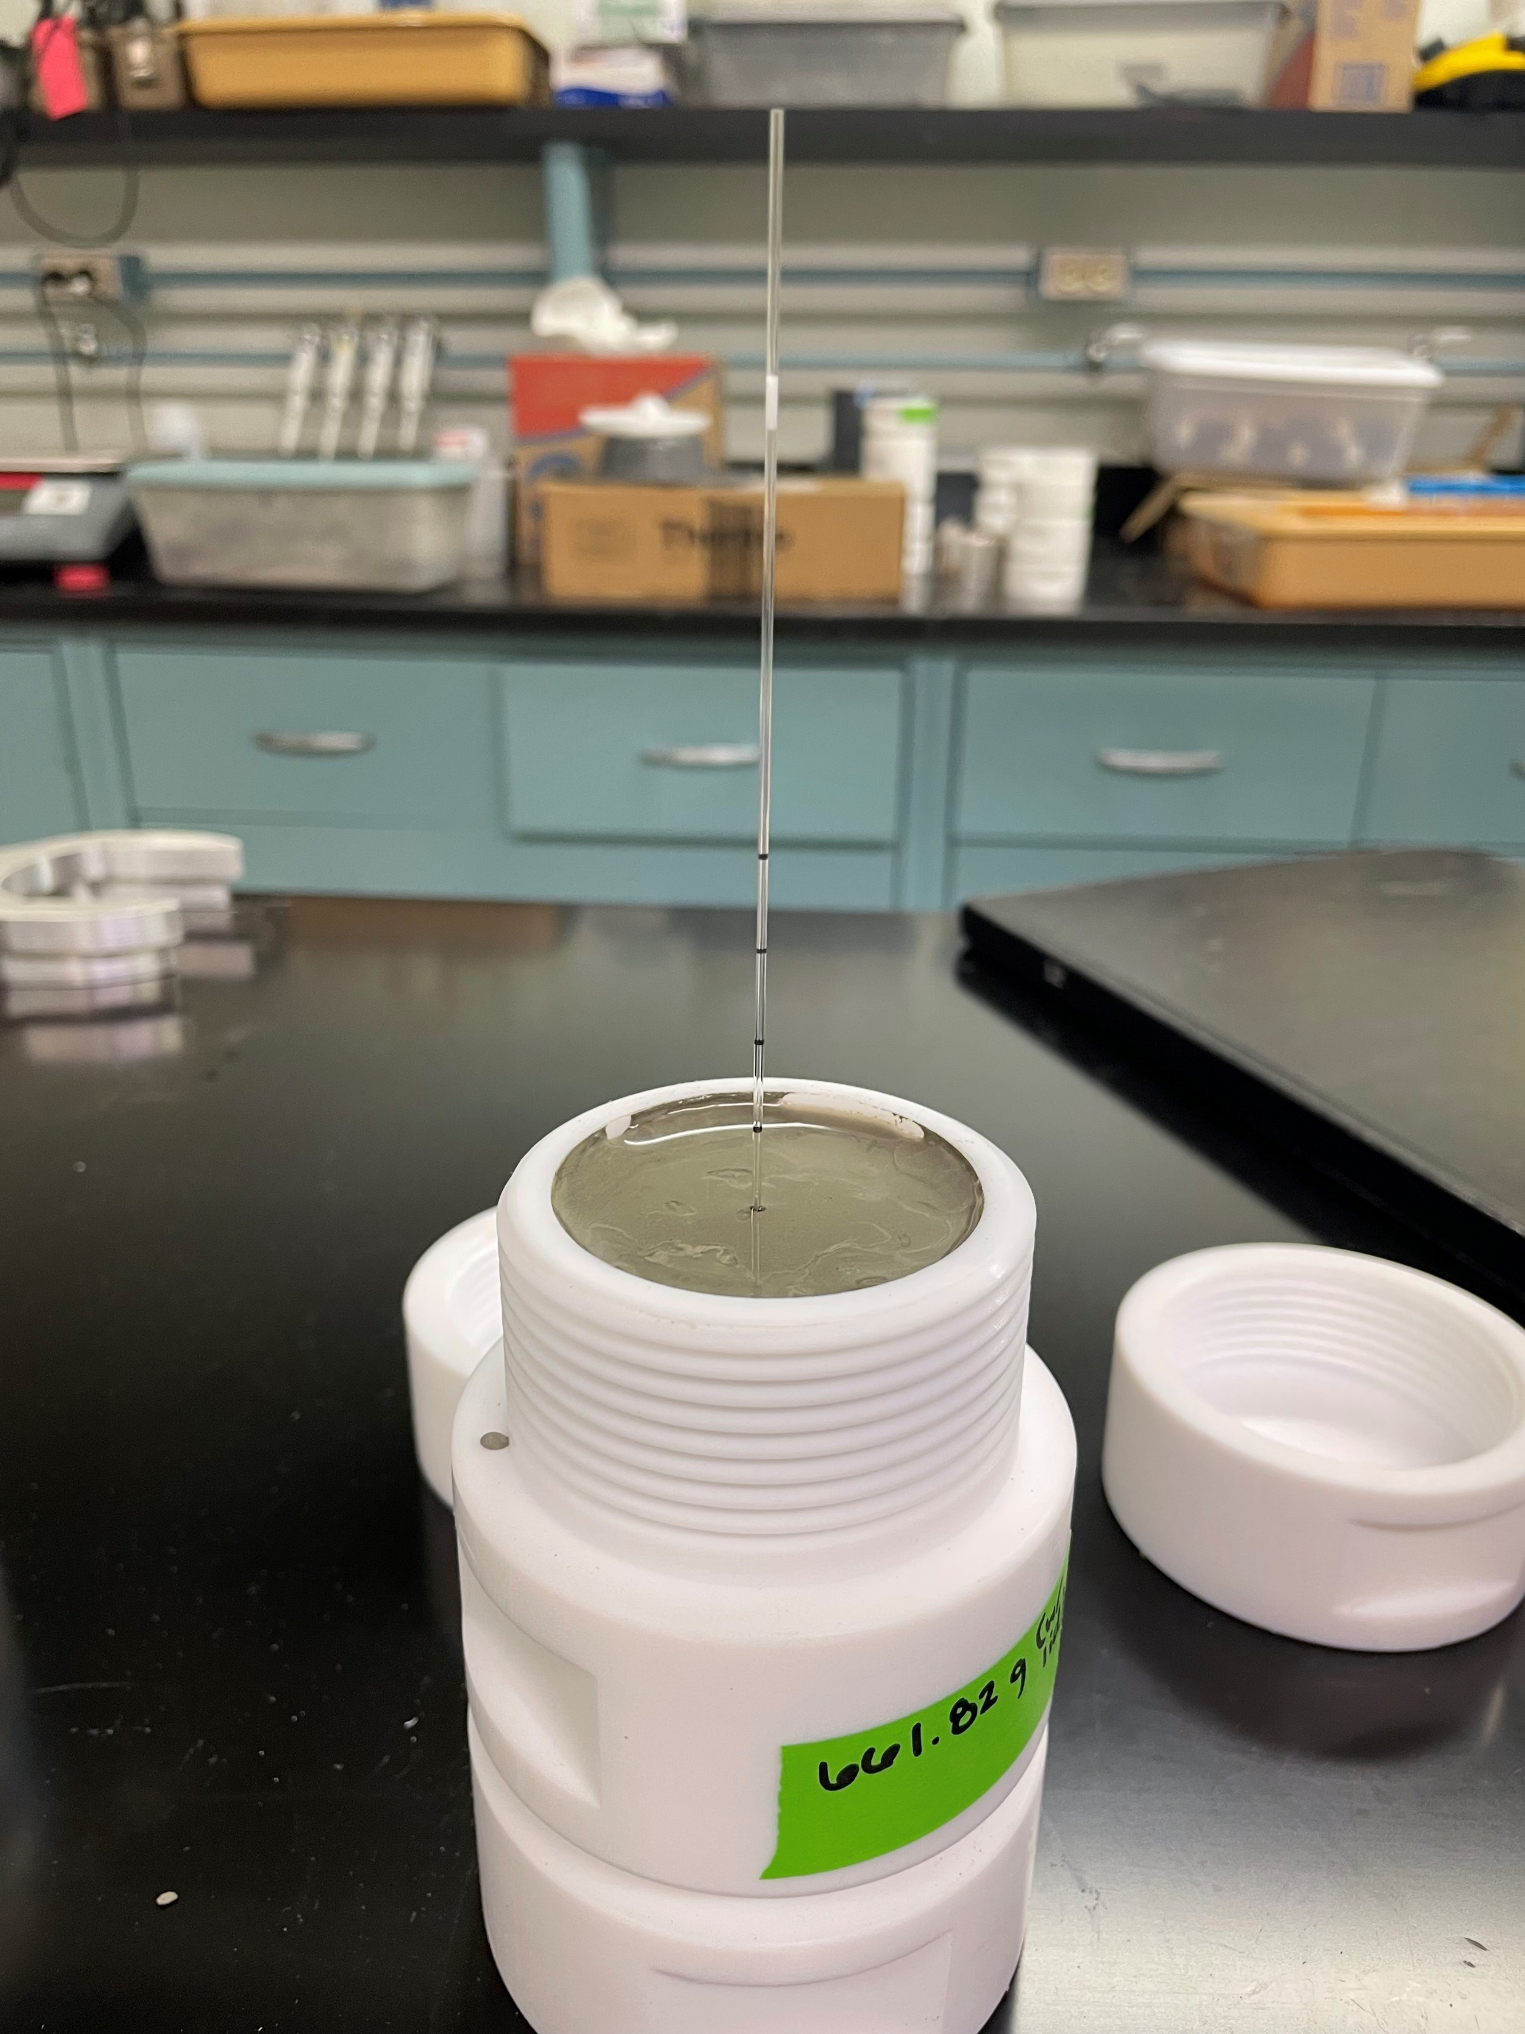
Solid Sample Preparation
HgCl₂ Mix:
40 mg Hg /kg material
Blend OPC and water, directly pipette HgCl₂ into mix during last minute of blending
Pour into cylindrical molds and PTFE bags, seal and cure
Hg(0) Mix:
40 mg Hg /kg material
Blend OPC and water, pour into cylindrical molds and allow to set for 30 minutes
Directly inject Hg(0) using micropipettes 1.3 cm into the center of each cylinder, then seal and cure
Cast undoped PTFE bags for baseline 1313 testing

Slide 12
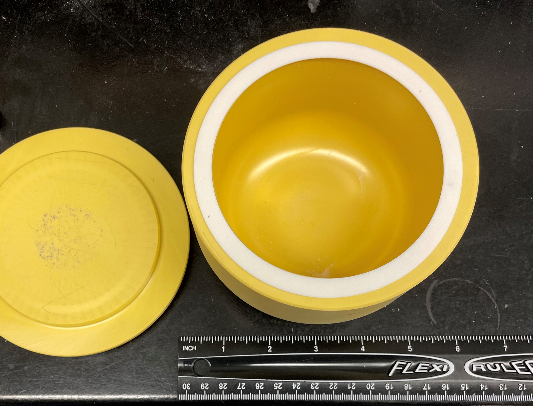
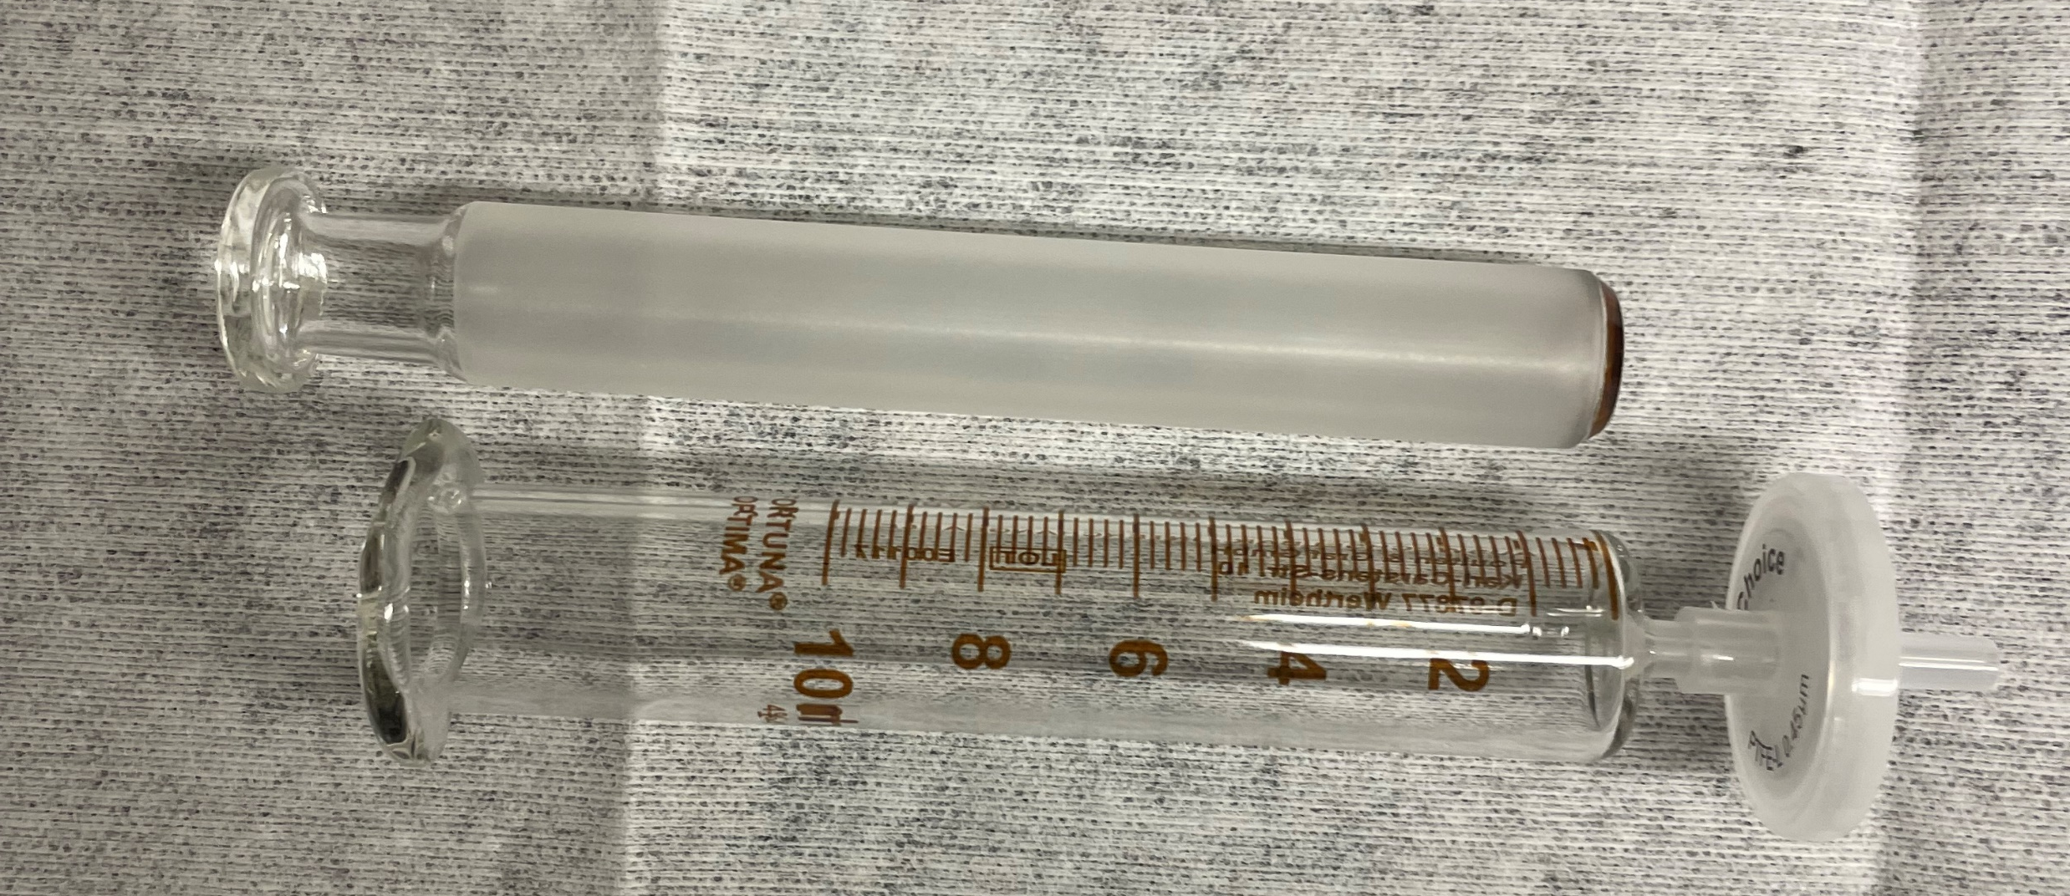
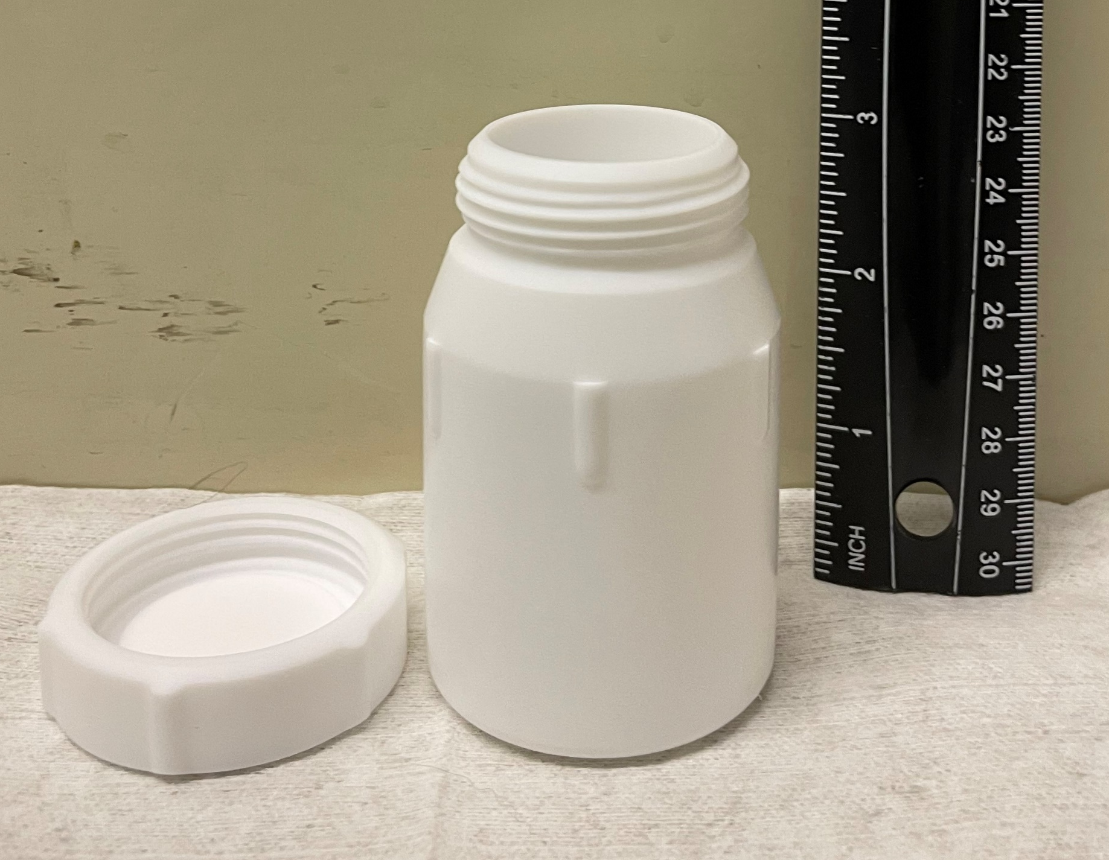
Sample Handling to Minimize Losses
Crushing Material
Planetary ball mill outfitted with magnesium stabilized zirconium milling media
Filtration
For pH < 9.0, use glass syringes with PTFE filter cartridges
For pH > 9.0, centrifuge and decant samples
Appropriate Vessels for Storage
Glass vials fitted with PTFE or PCTFE lid liners
PTFE bottles or bags

Slide 13
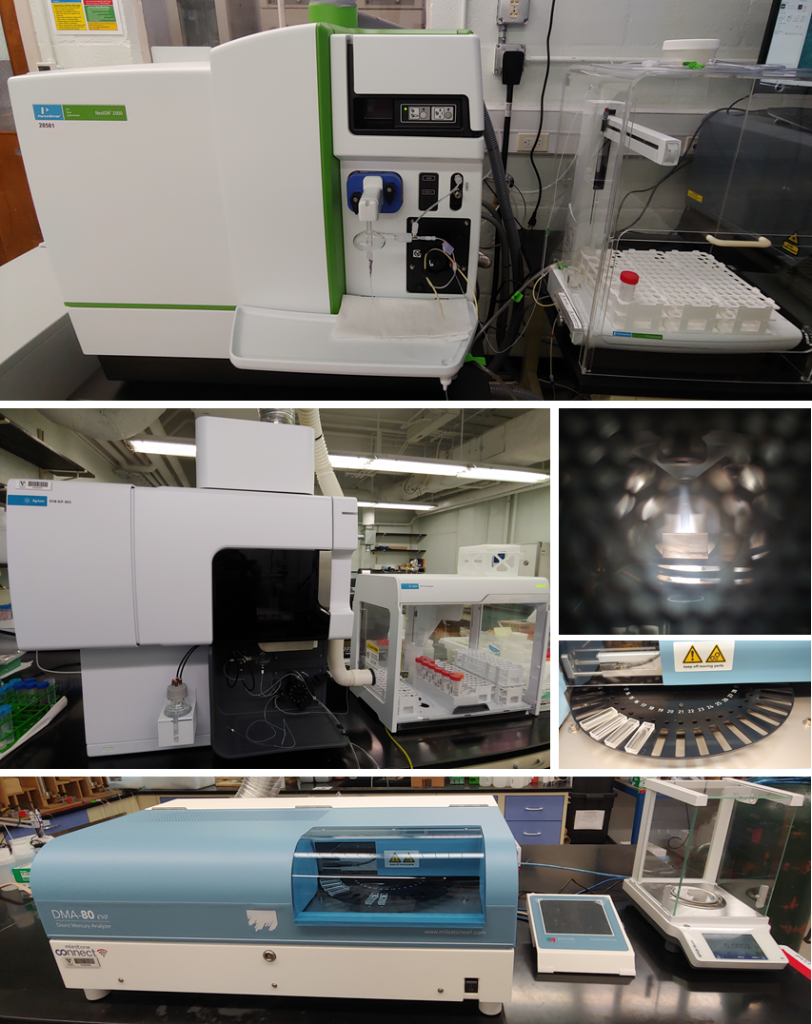
Mercury Sample Characterization
Liquid samples - preparation
1% nitric acid sample matrix (Christmann, 1976)
Gold addition at 200 µg/L for stabilization
Added to both calibration standards and samples
Liquid samples - analytical
Inductively coupled plasma mass spectrometer (ICP-MS)
EPA Method 6020B
22 ng/L (ppt) detection limit for Hg⁰
Inductively coupled plasma optical emission spectrometer (ICP-OES)
EPA Method 6010D
10 µg/L (ppb) detection limit for Hg⁰
Solid samples
Mercury analyzer with integrated balance
Typical samples have particle size ≤ 2 mm
EPA Method 7473
1 ng/g (ppb) detection limit for Hg⁰

Slide 14
Next Steps
Continue Method 1315 with HgCl₂ OPC samples
Complete sample prep for HgCl₂ OPC, and complete Method 1313
Begin Method 1315 with Hg(0) samples after curing is complete
Complete baseline Method 1313 with undoped OPC for use in modeling of Hg(0)

